Slide 1
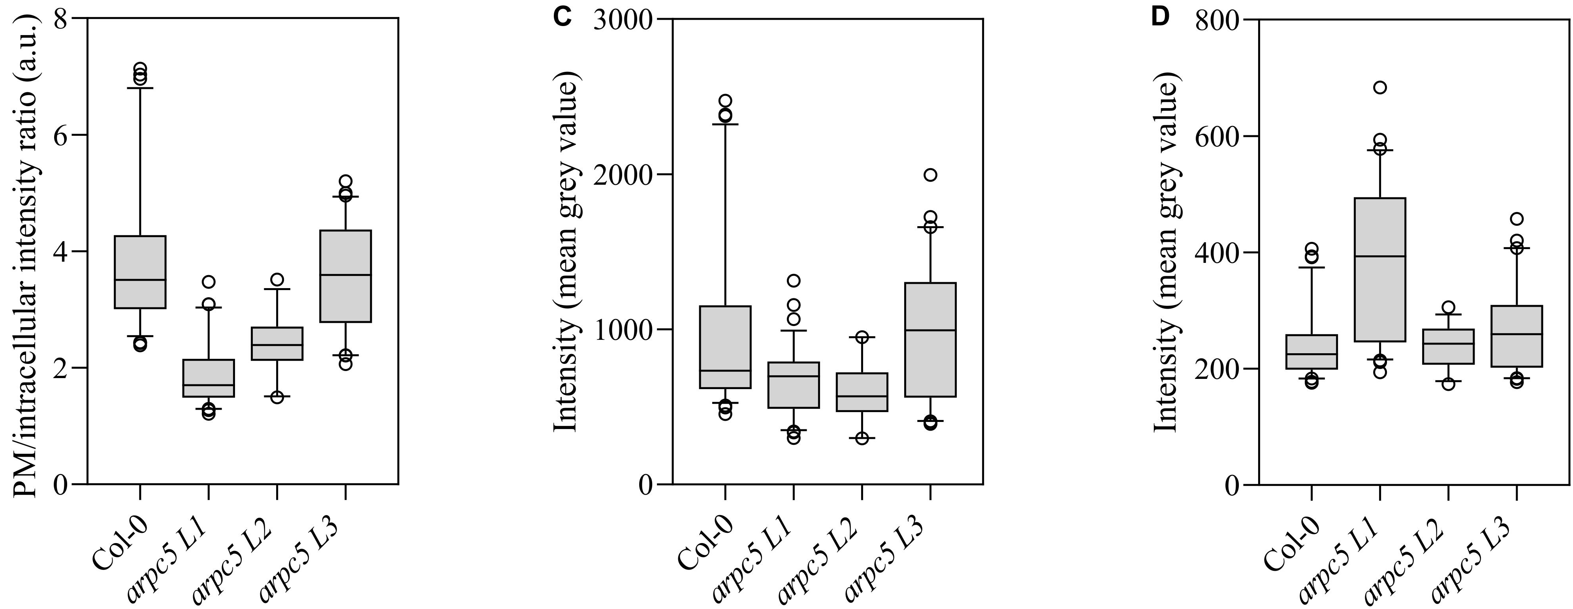
pPIN3::PIN3:YFP x arpc5
PM
Intracellular signal

Slide 2
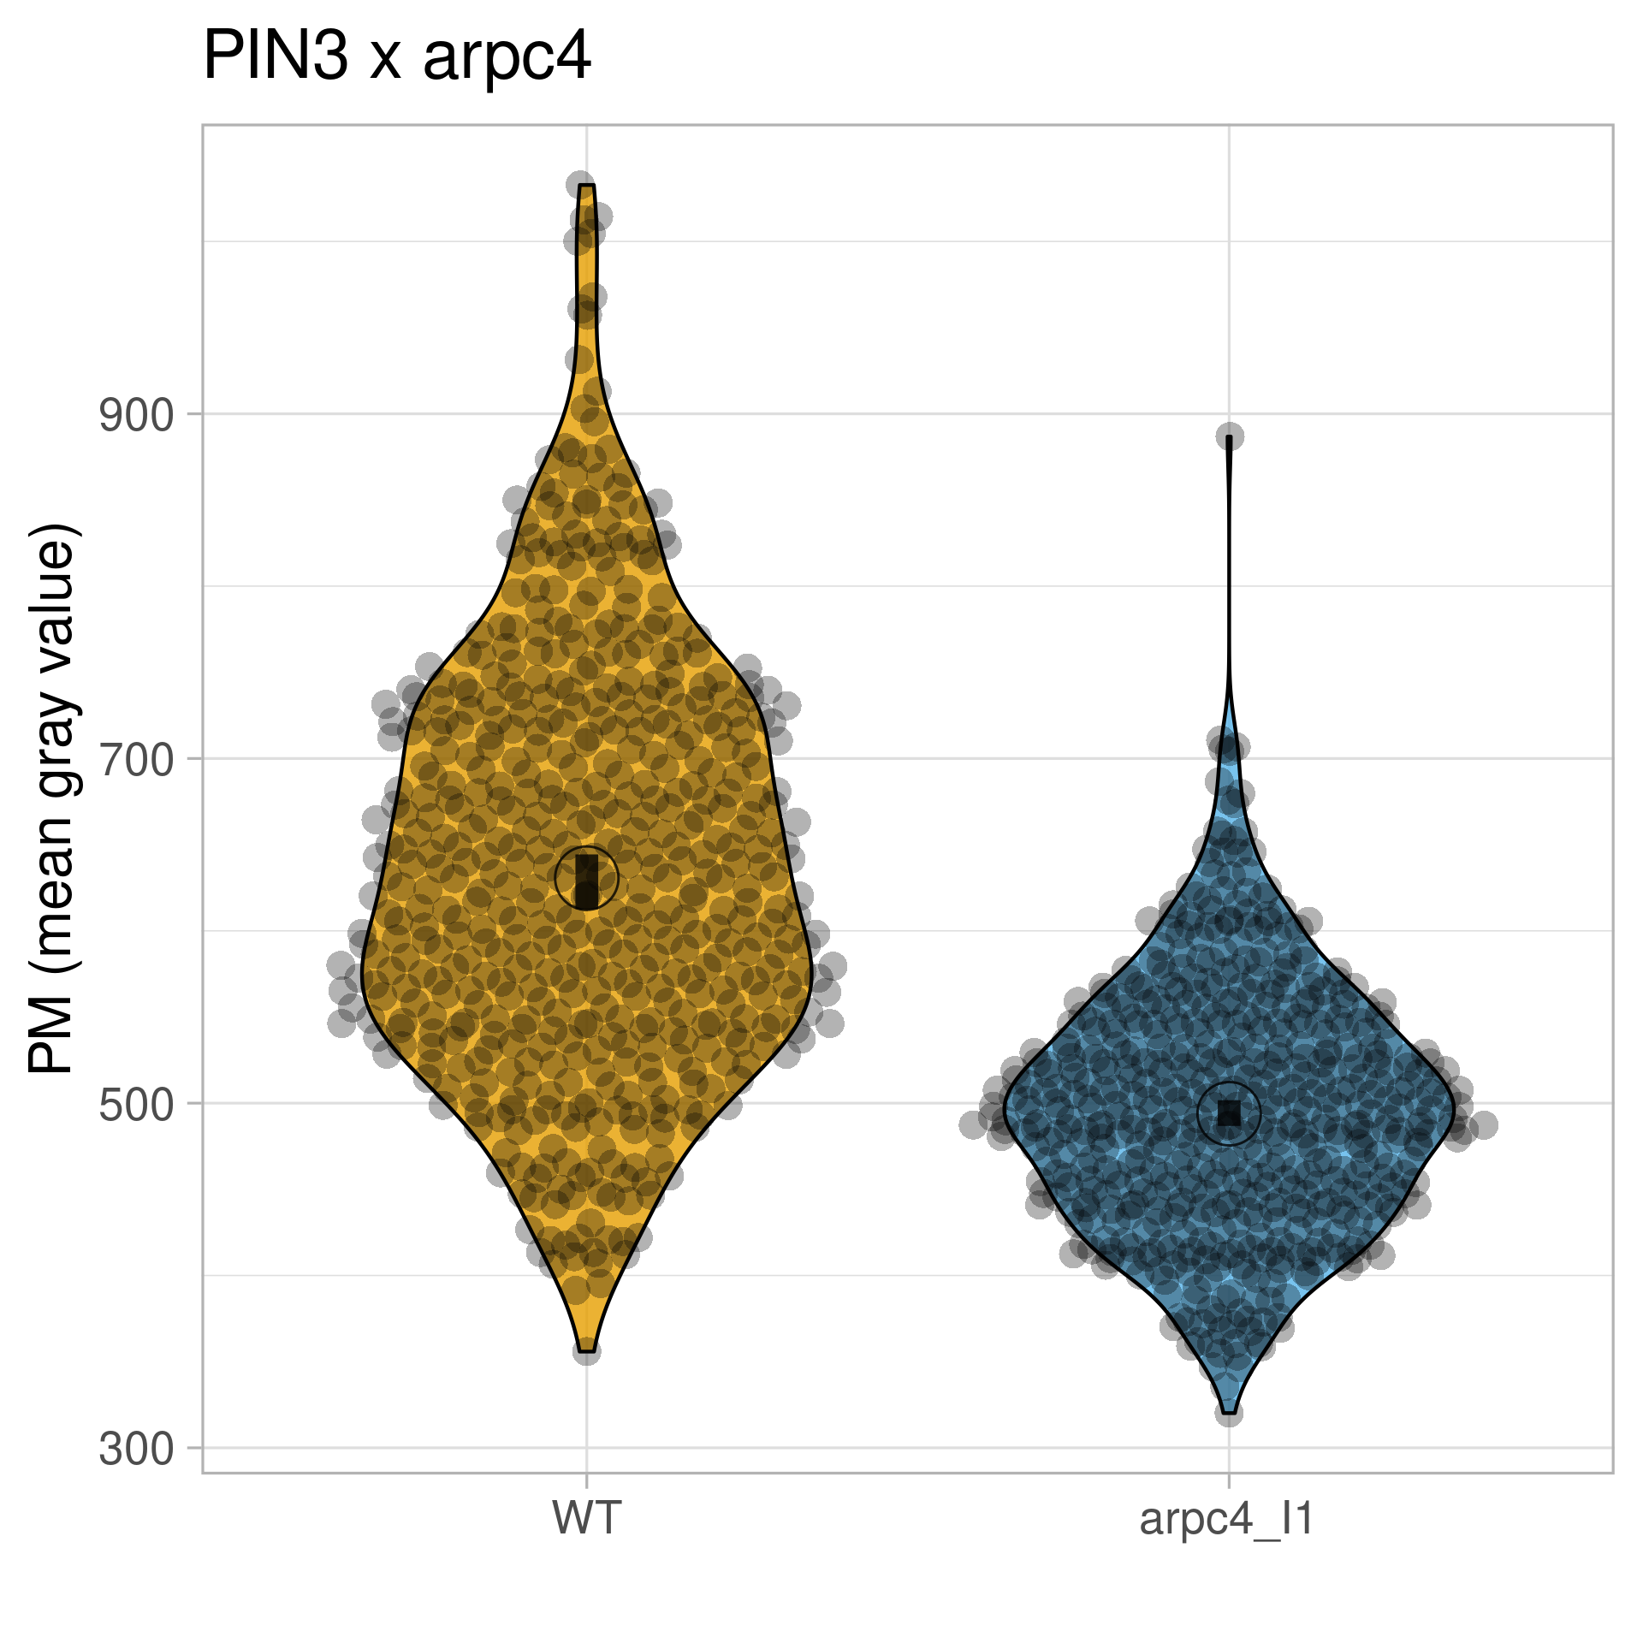
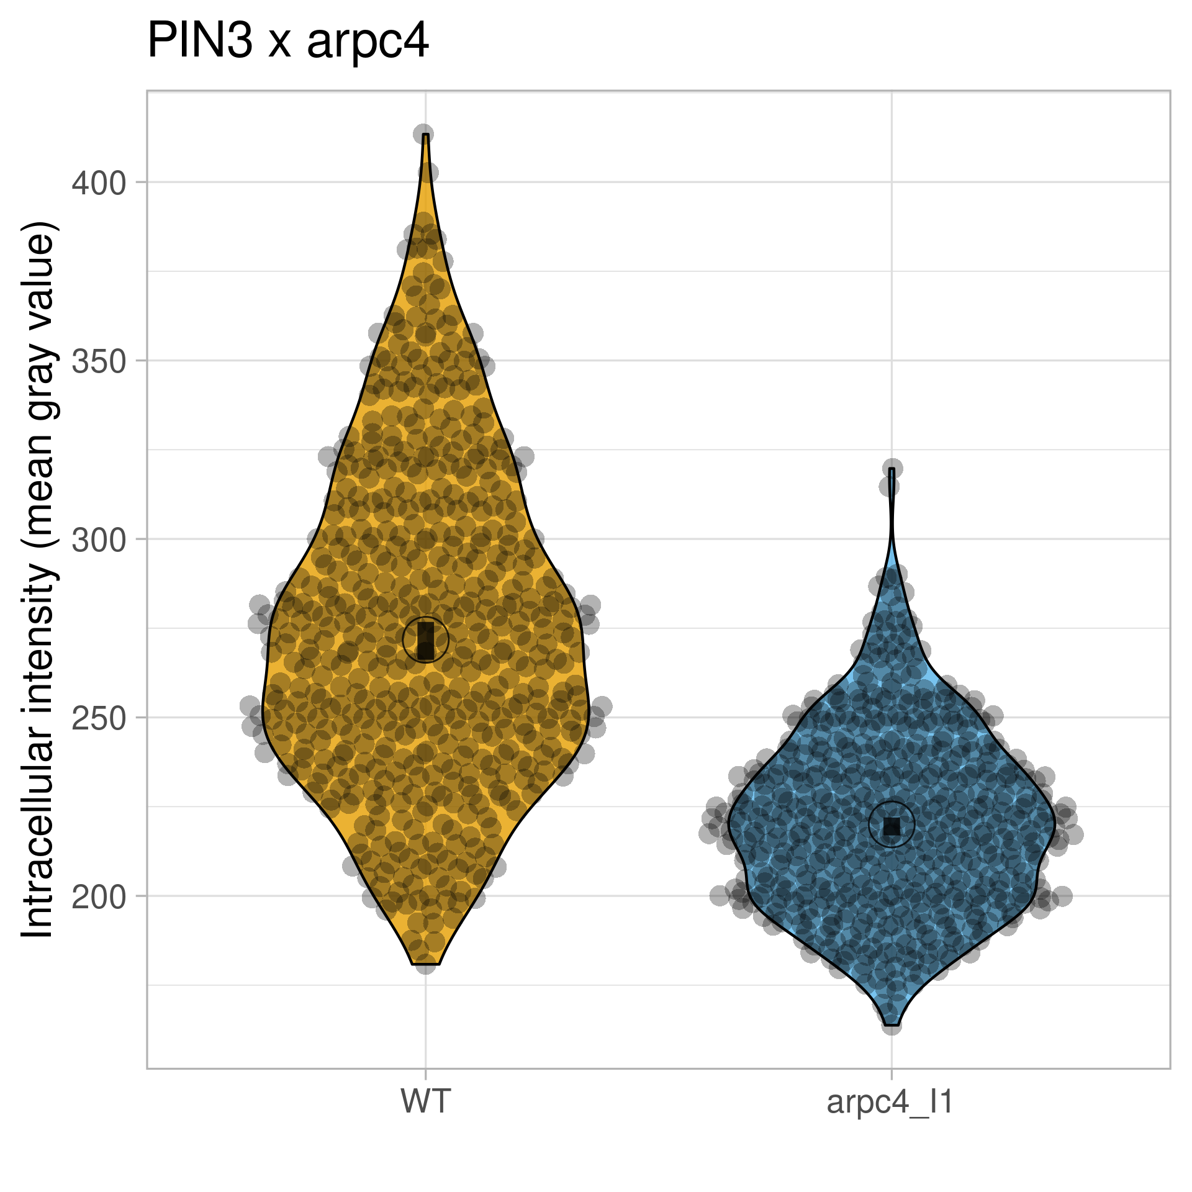
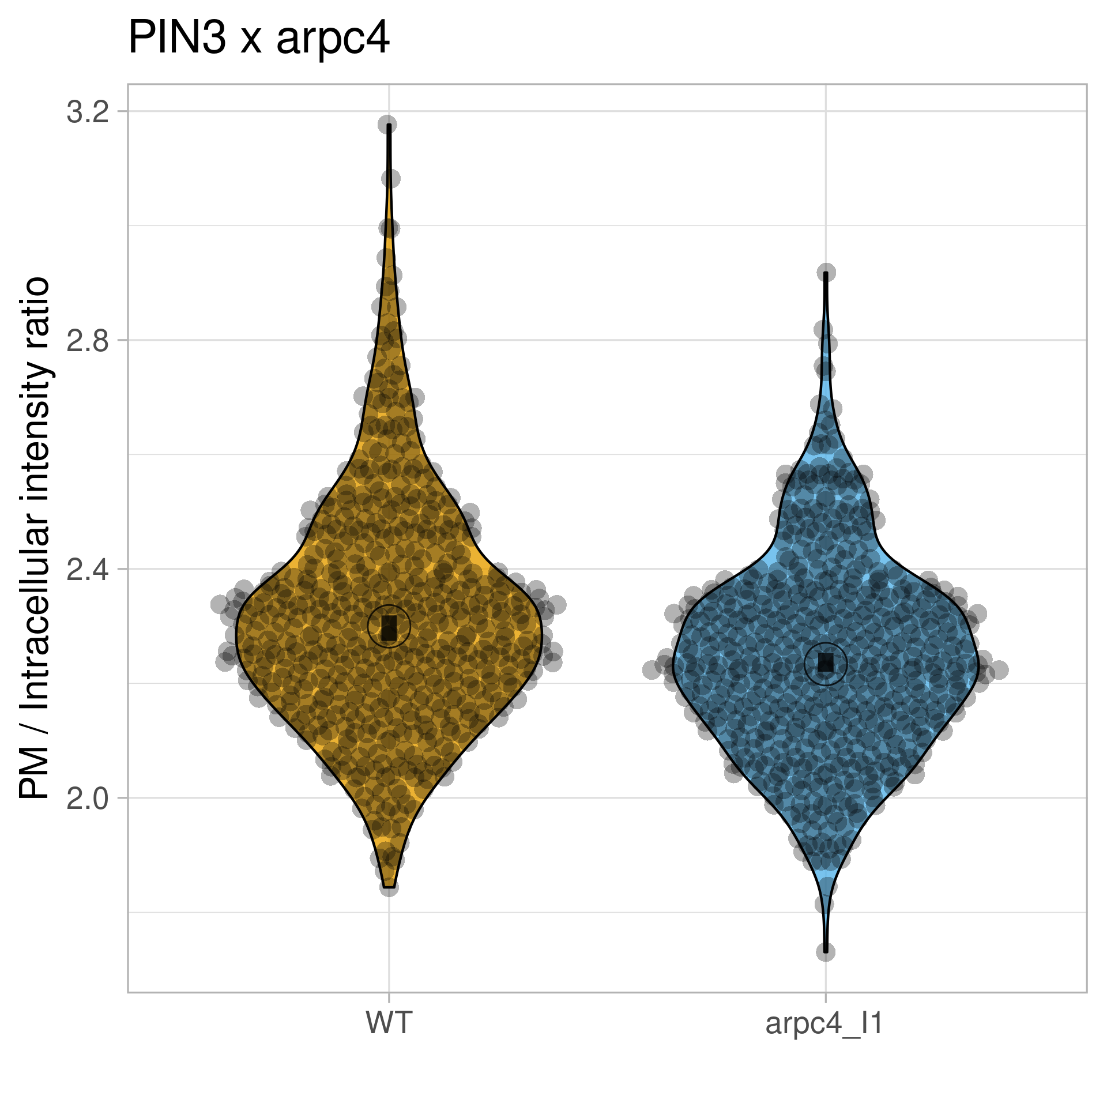
pPIN3::PIN3:YFP x arpc4
Statistics – Violin Plot + 95% CI

Slide 3
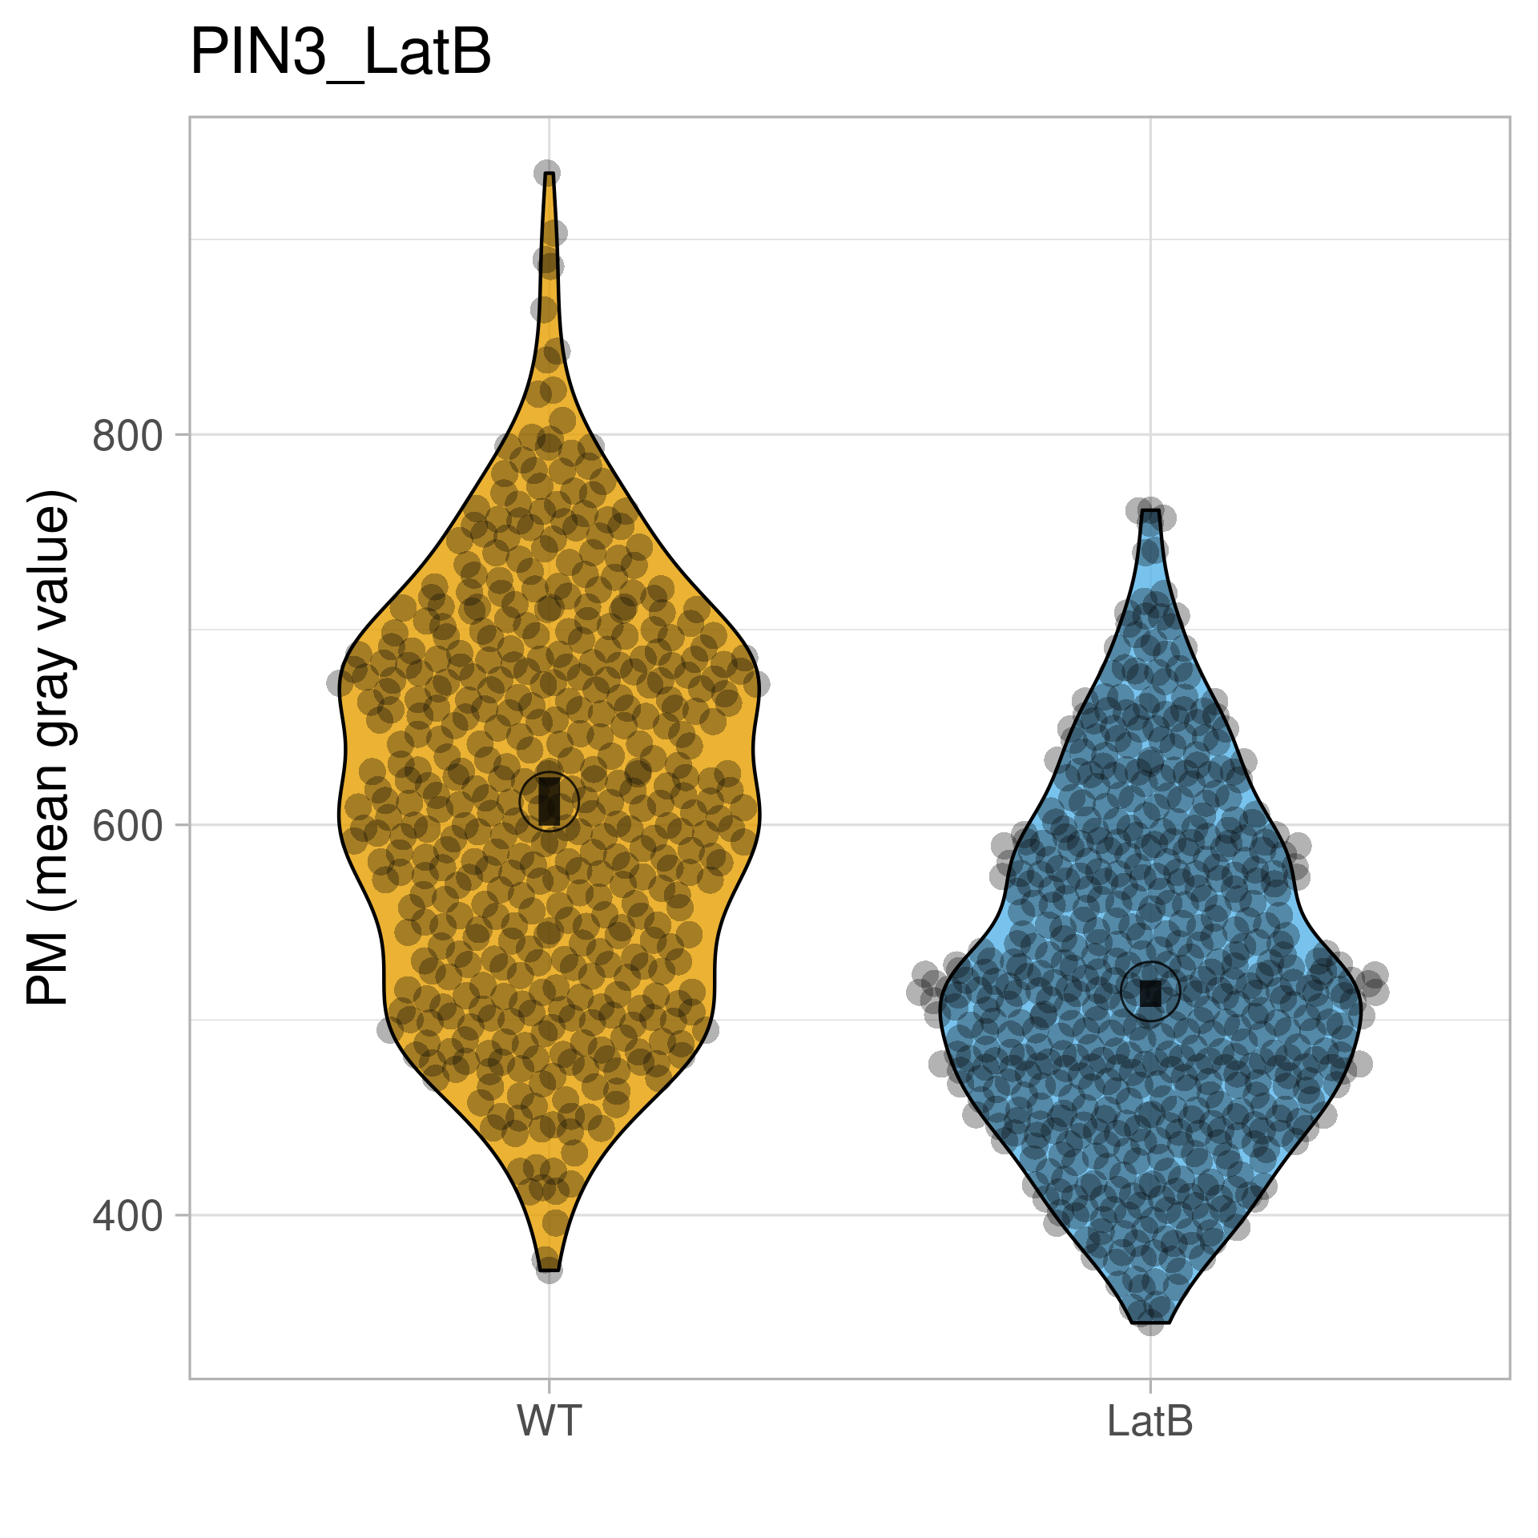
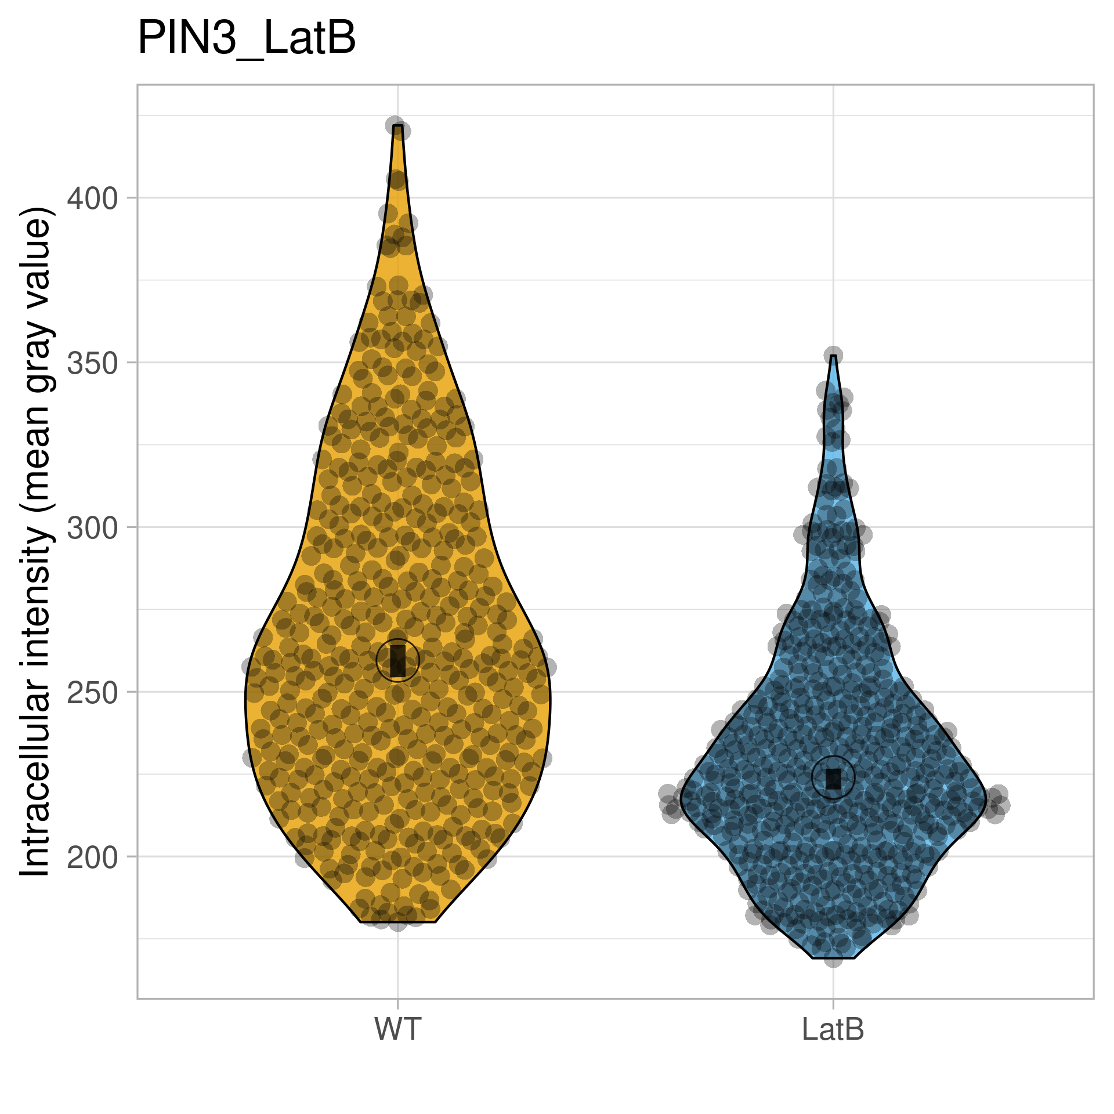
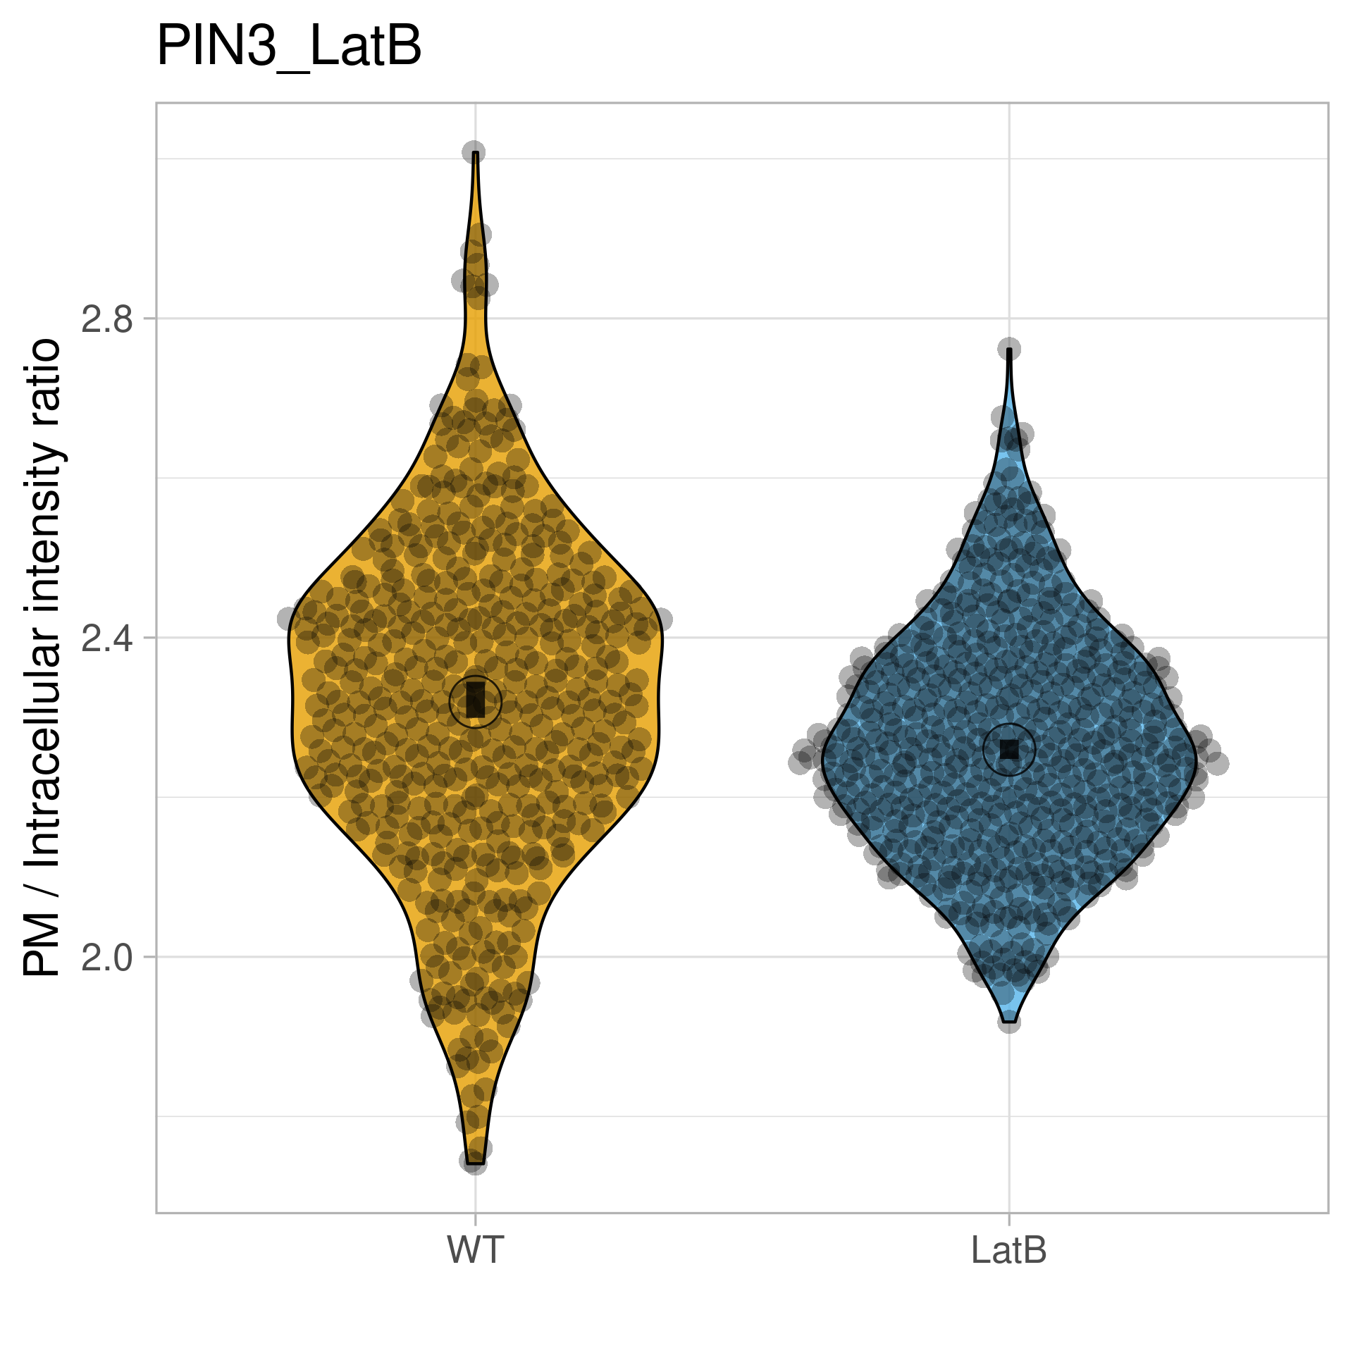
pPIN3::PIN3:YFP – LatB
Statistics – Violin Plot + 95% CI

Slide 4
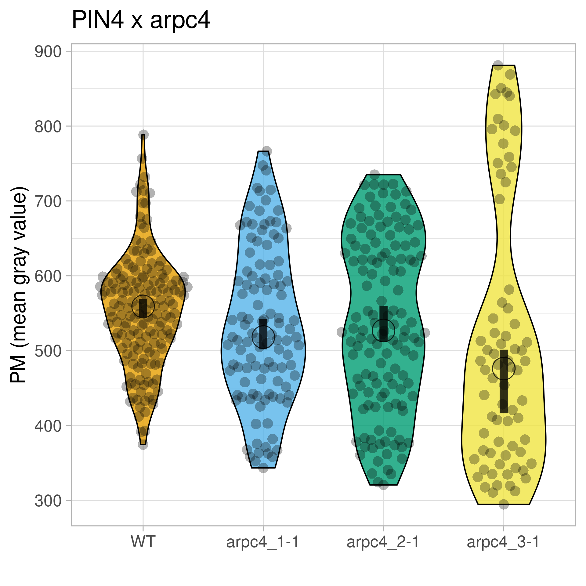
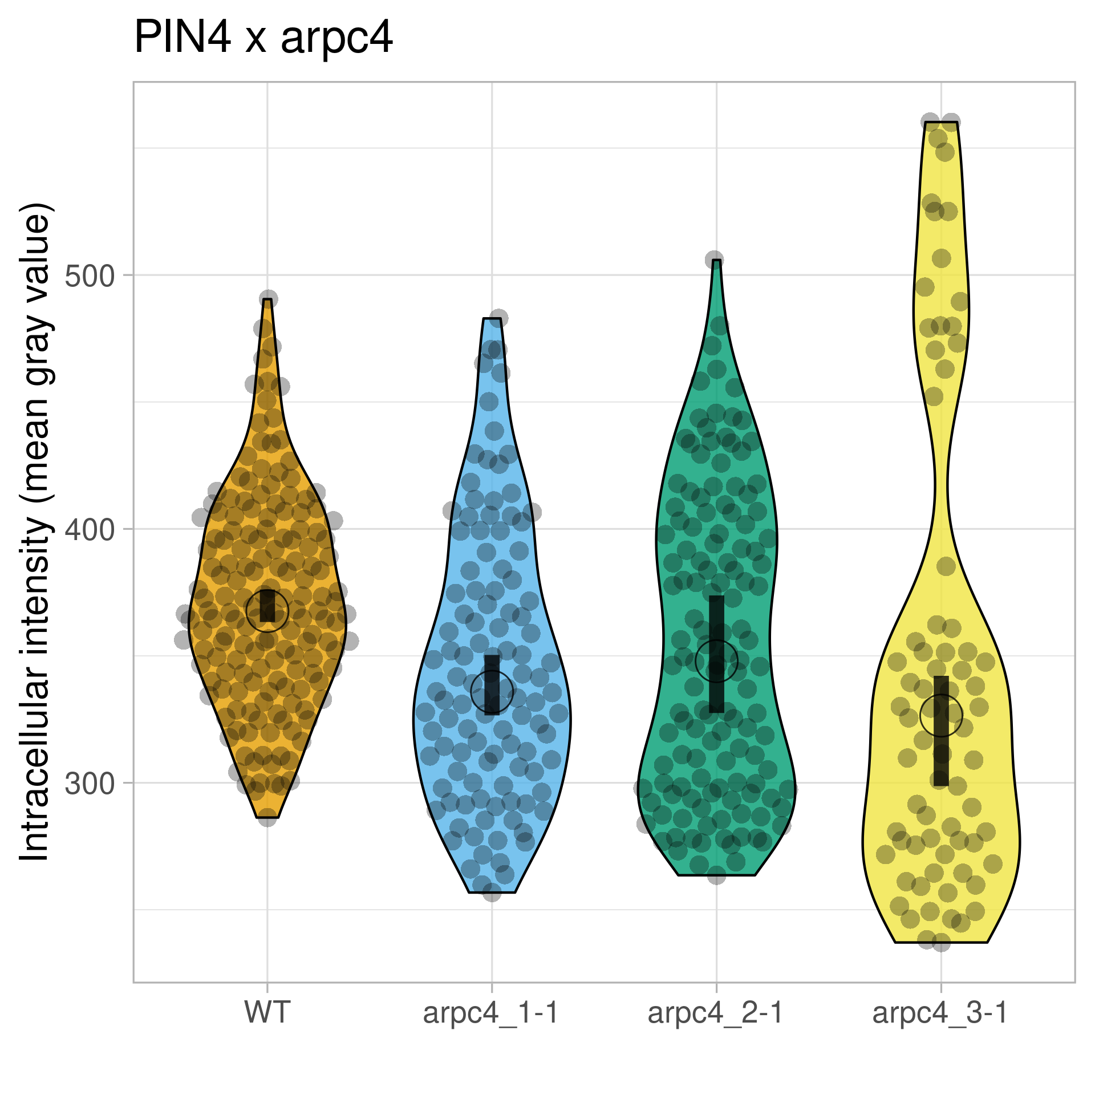
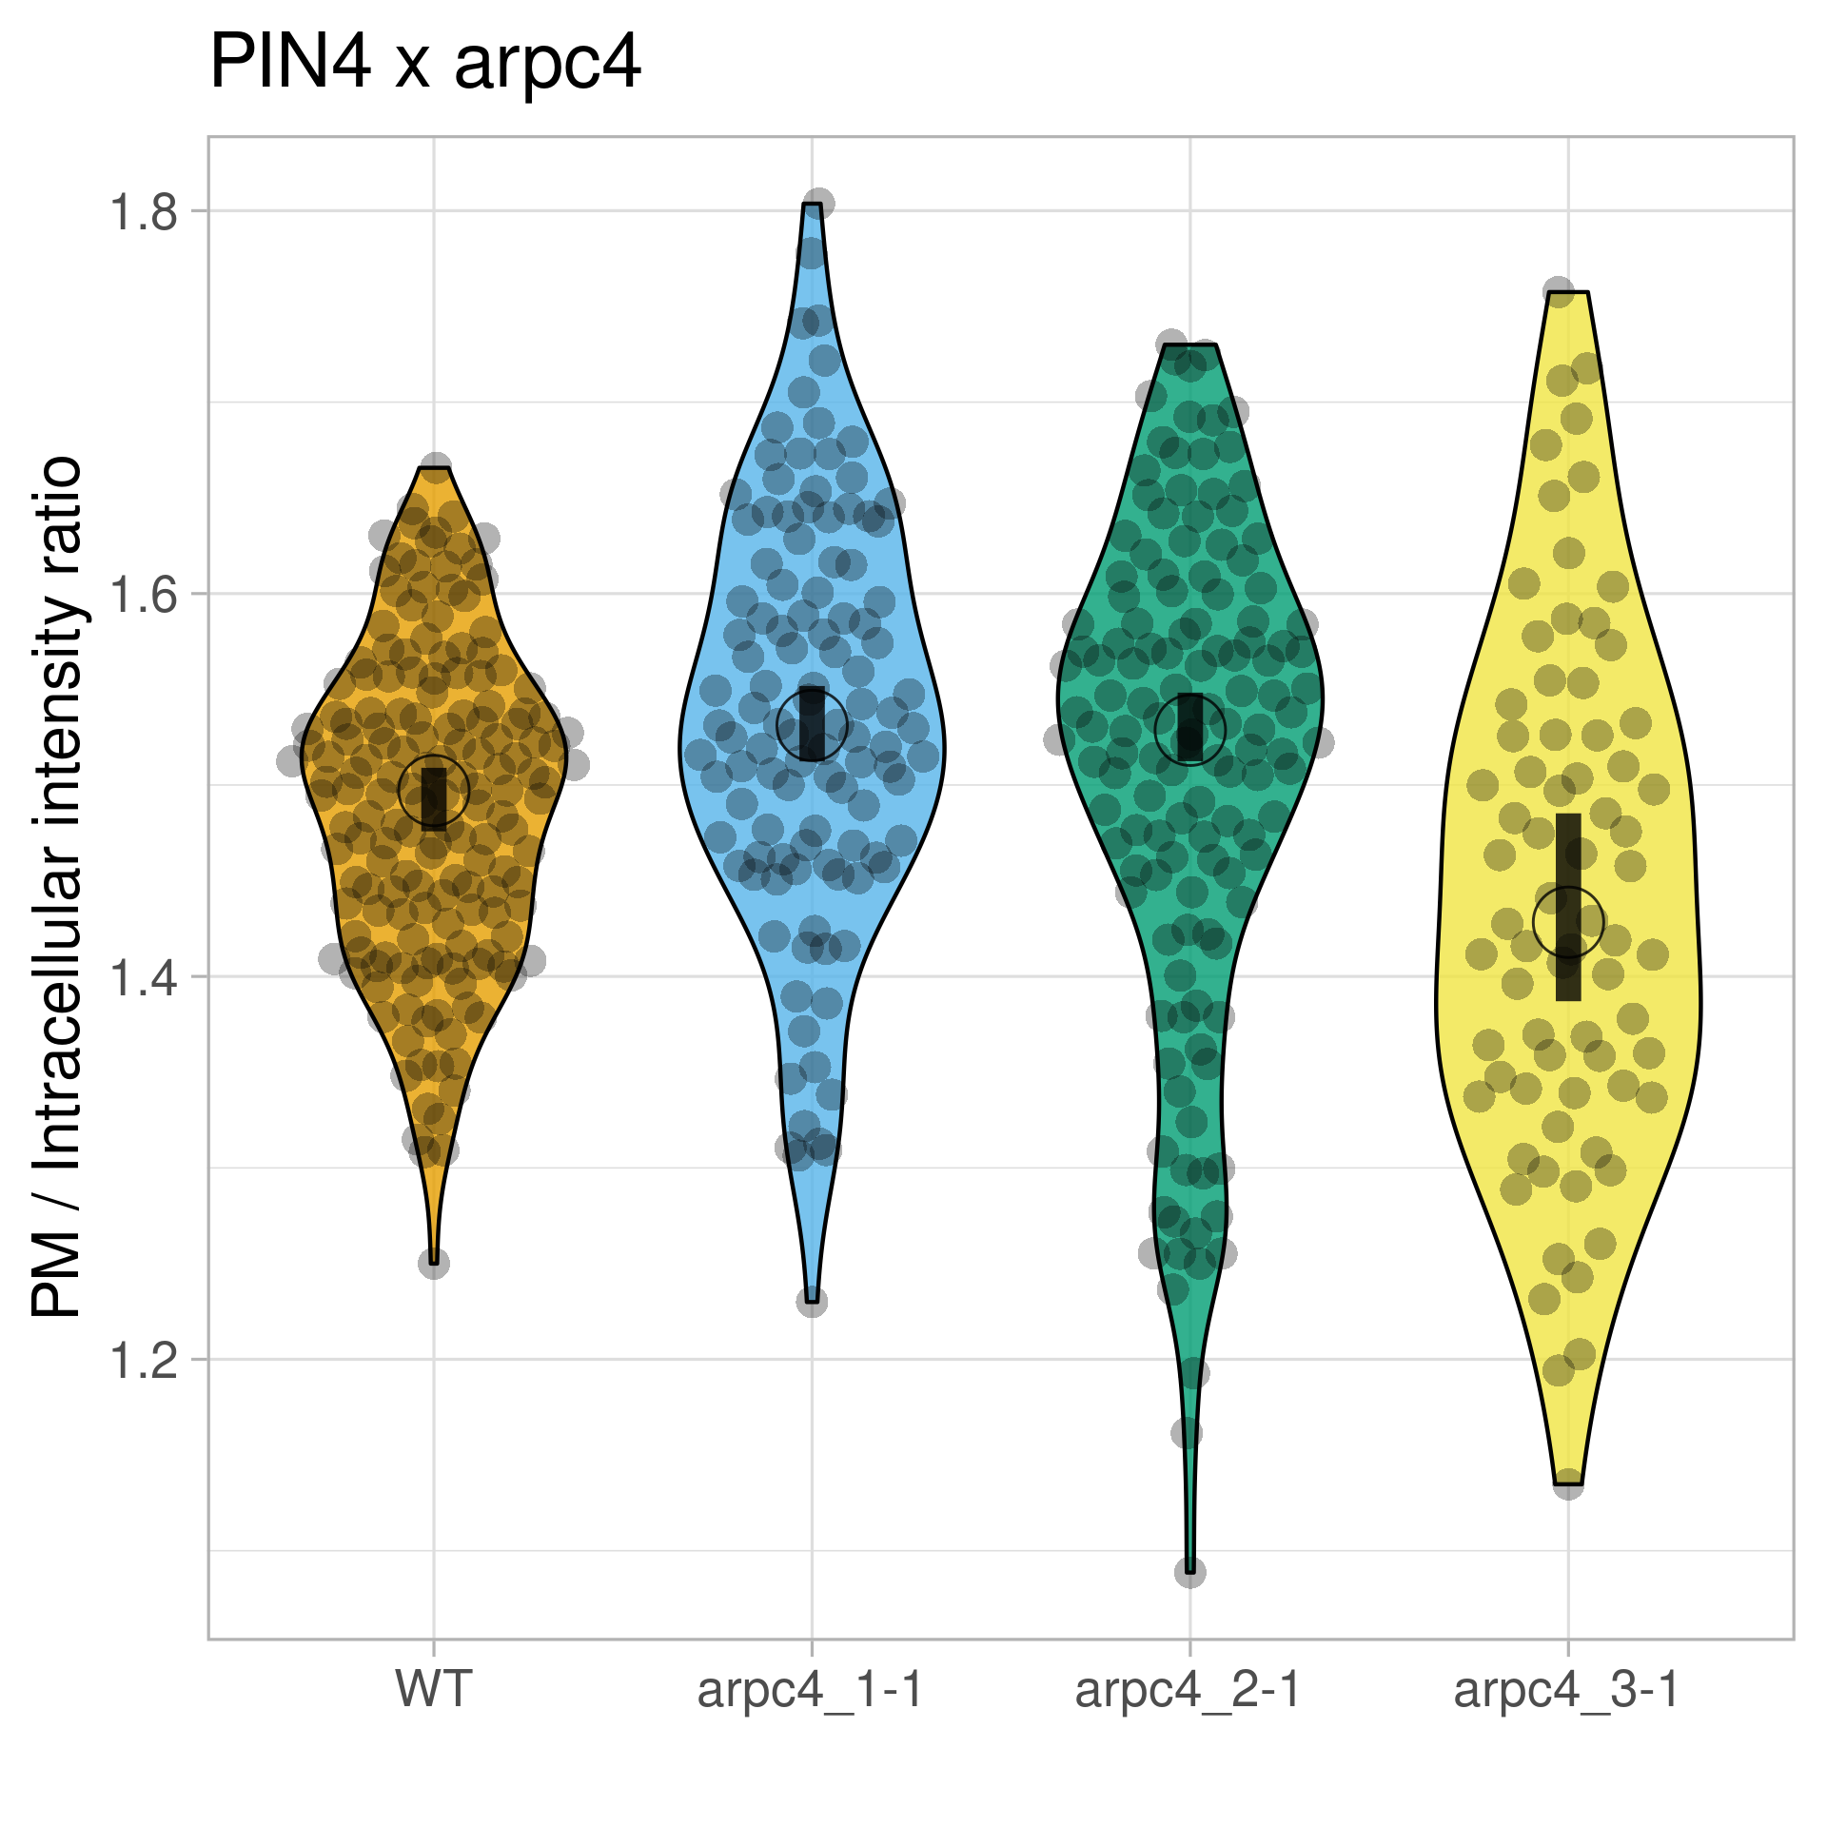
pPIN4::PIN4:GFP x arpc4
Statistics – Violin Plot + 95% CI

Slide 5
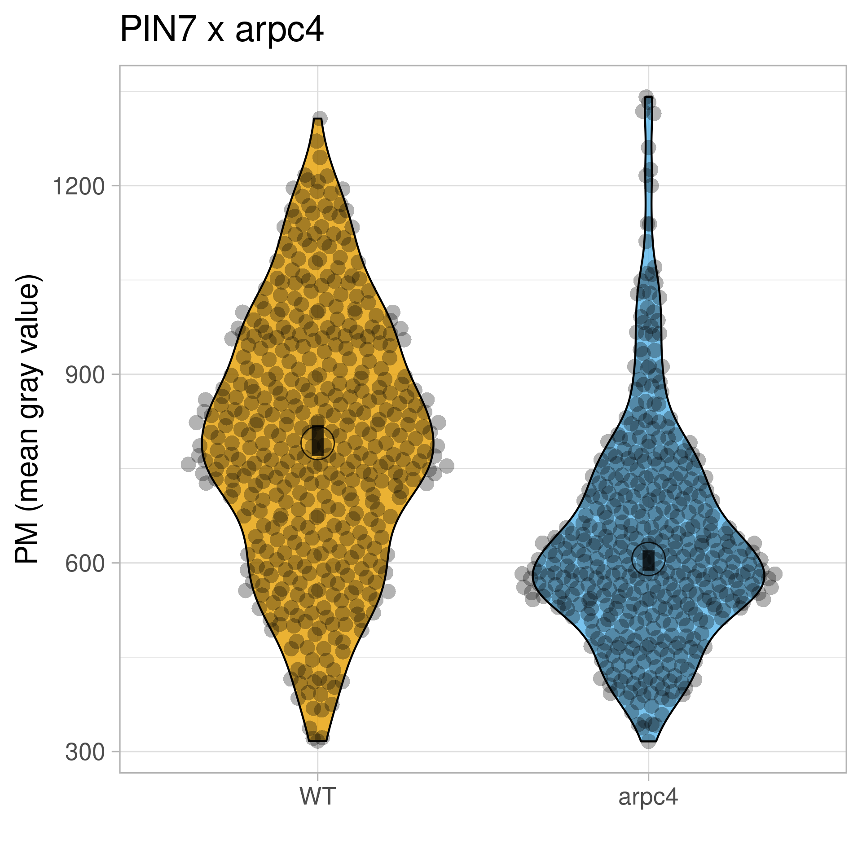
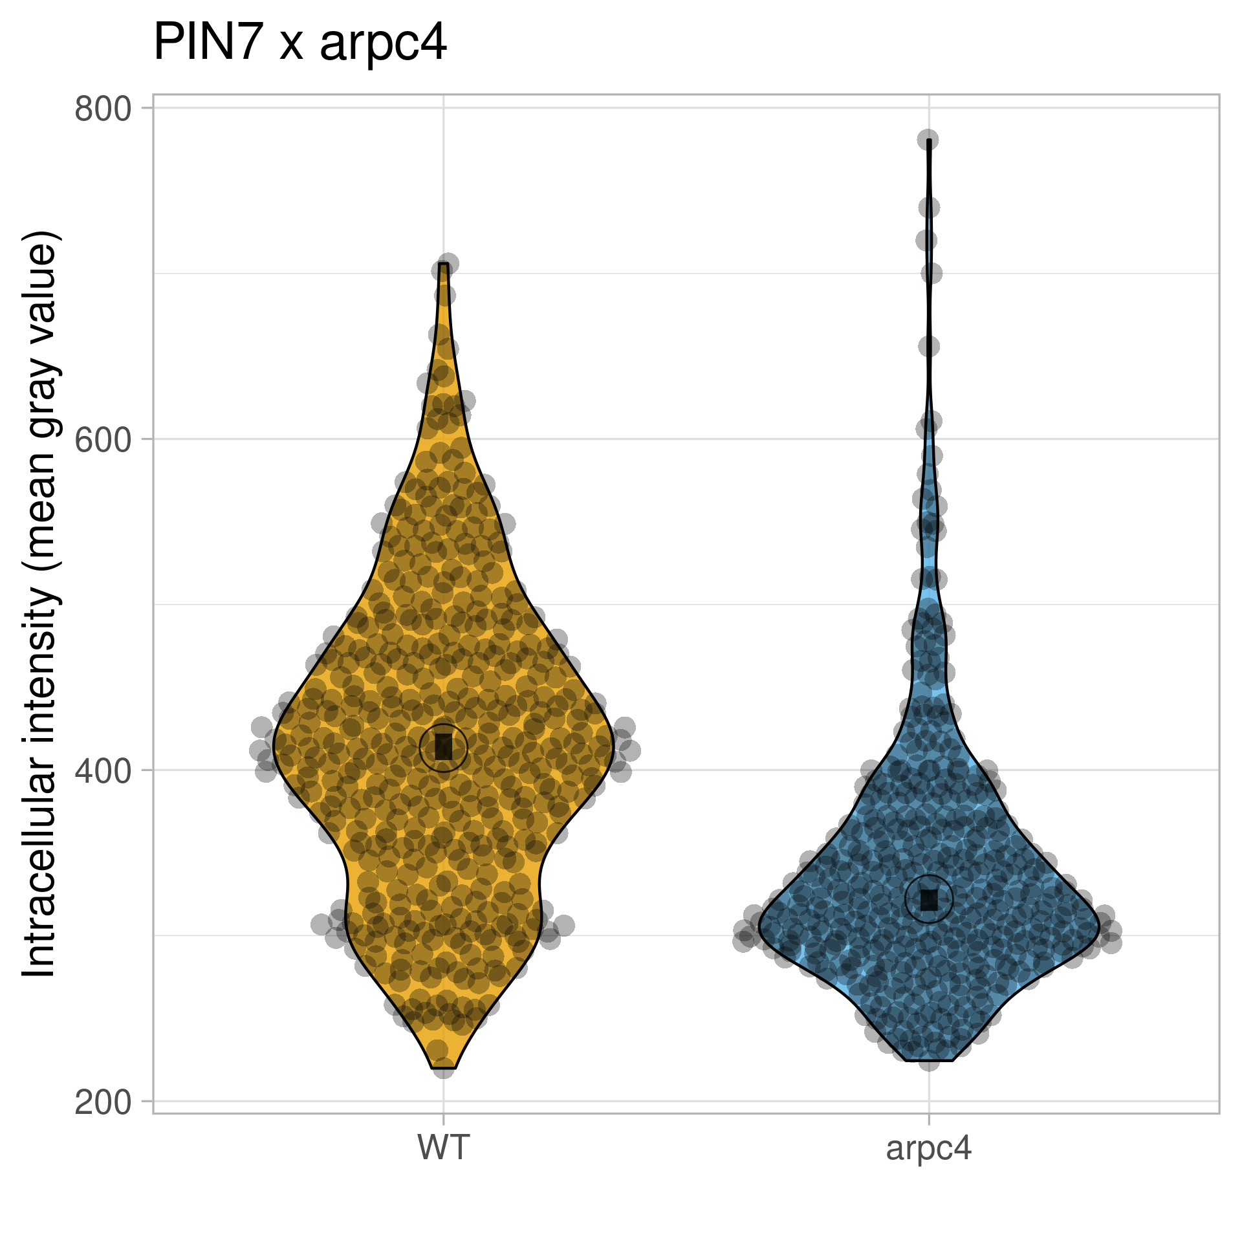
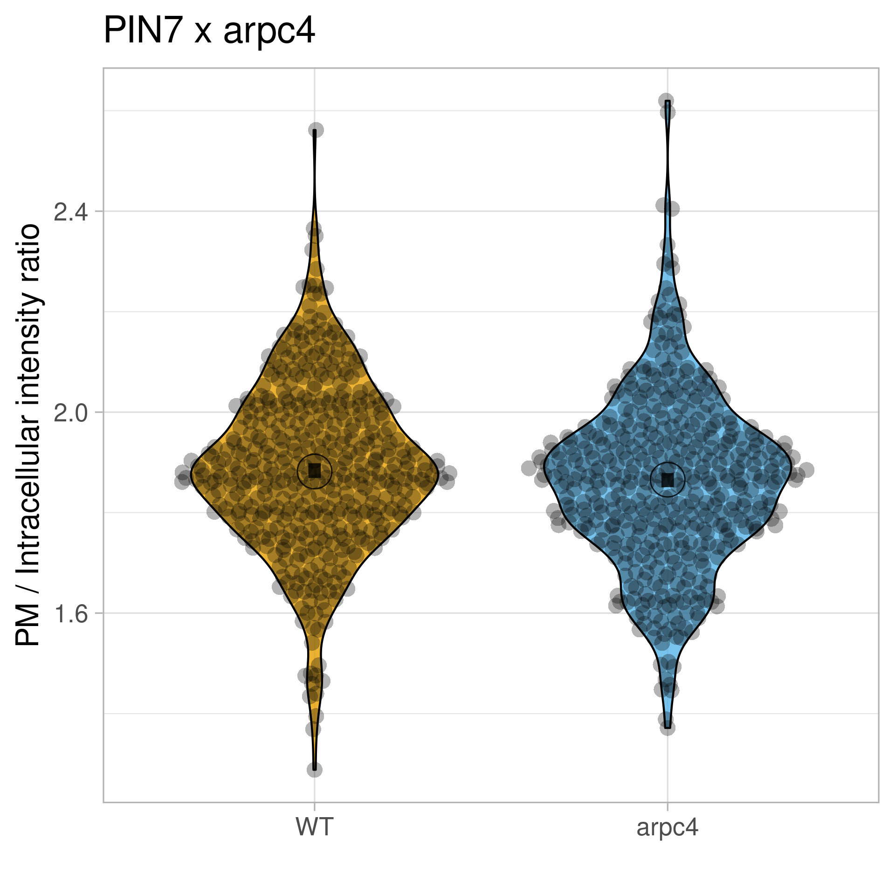
pPIN7::PIN7:GFP x arpc4
Statistics – Violin Plot + 95% CI

Slide 6
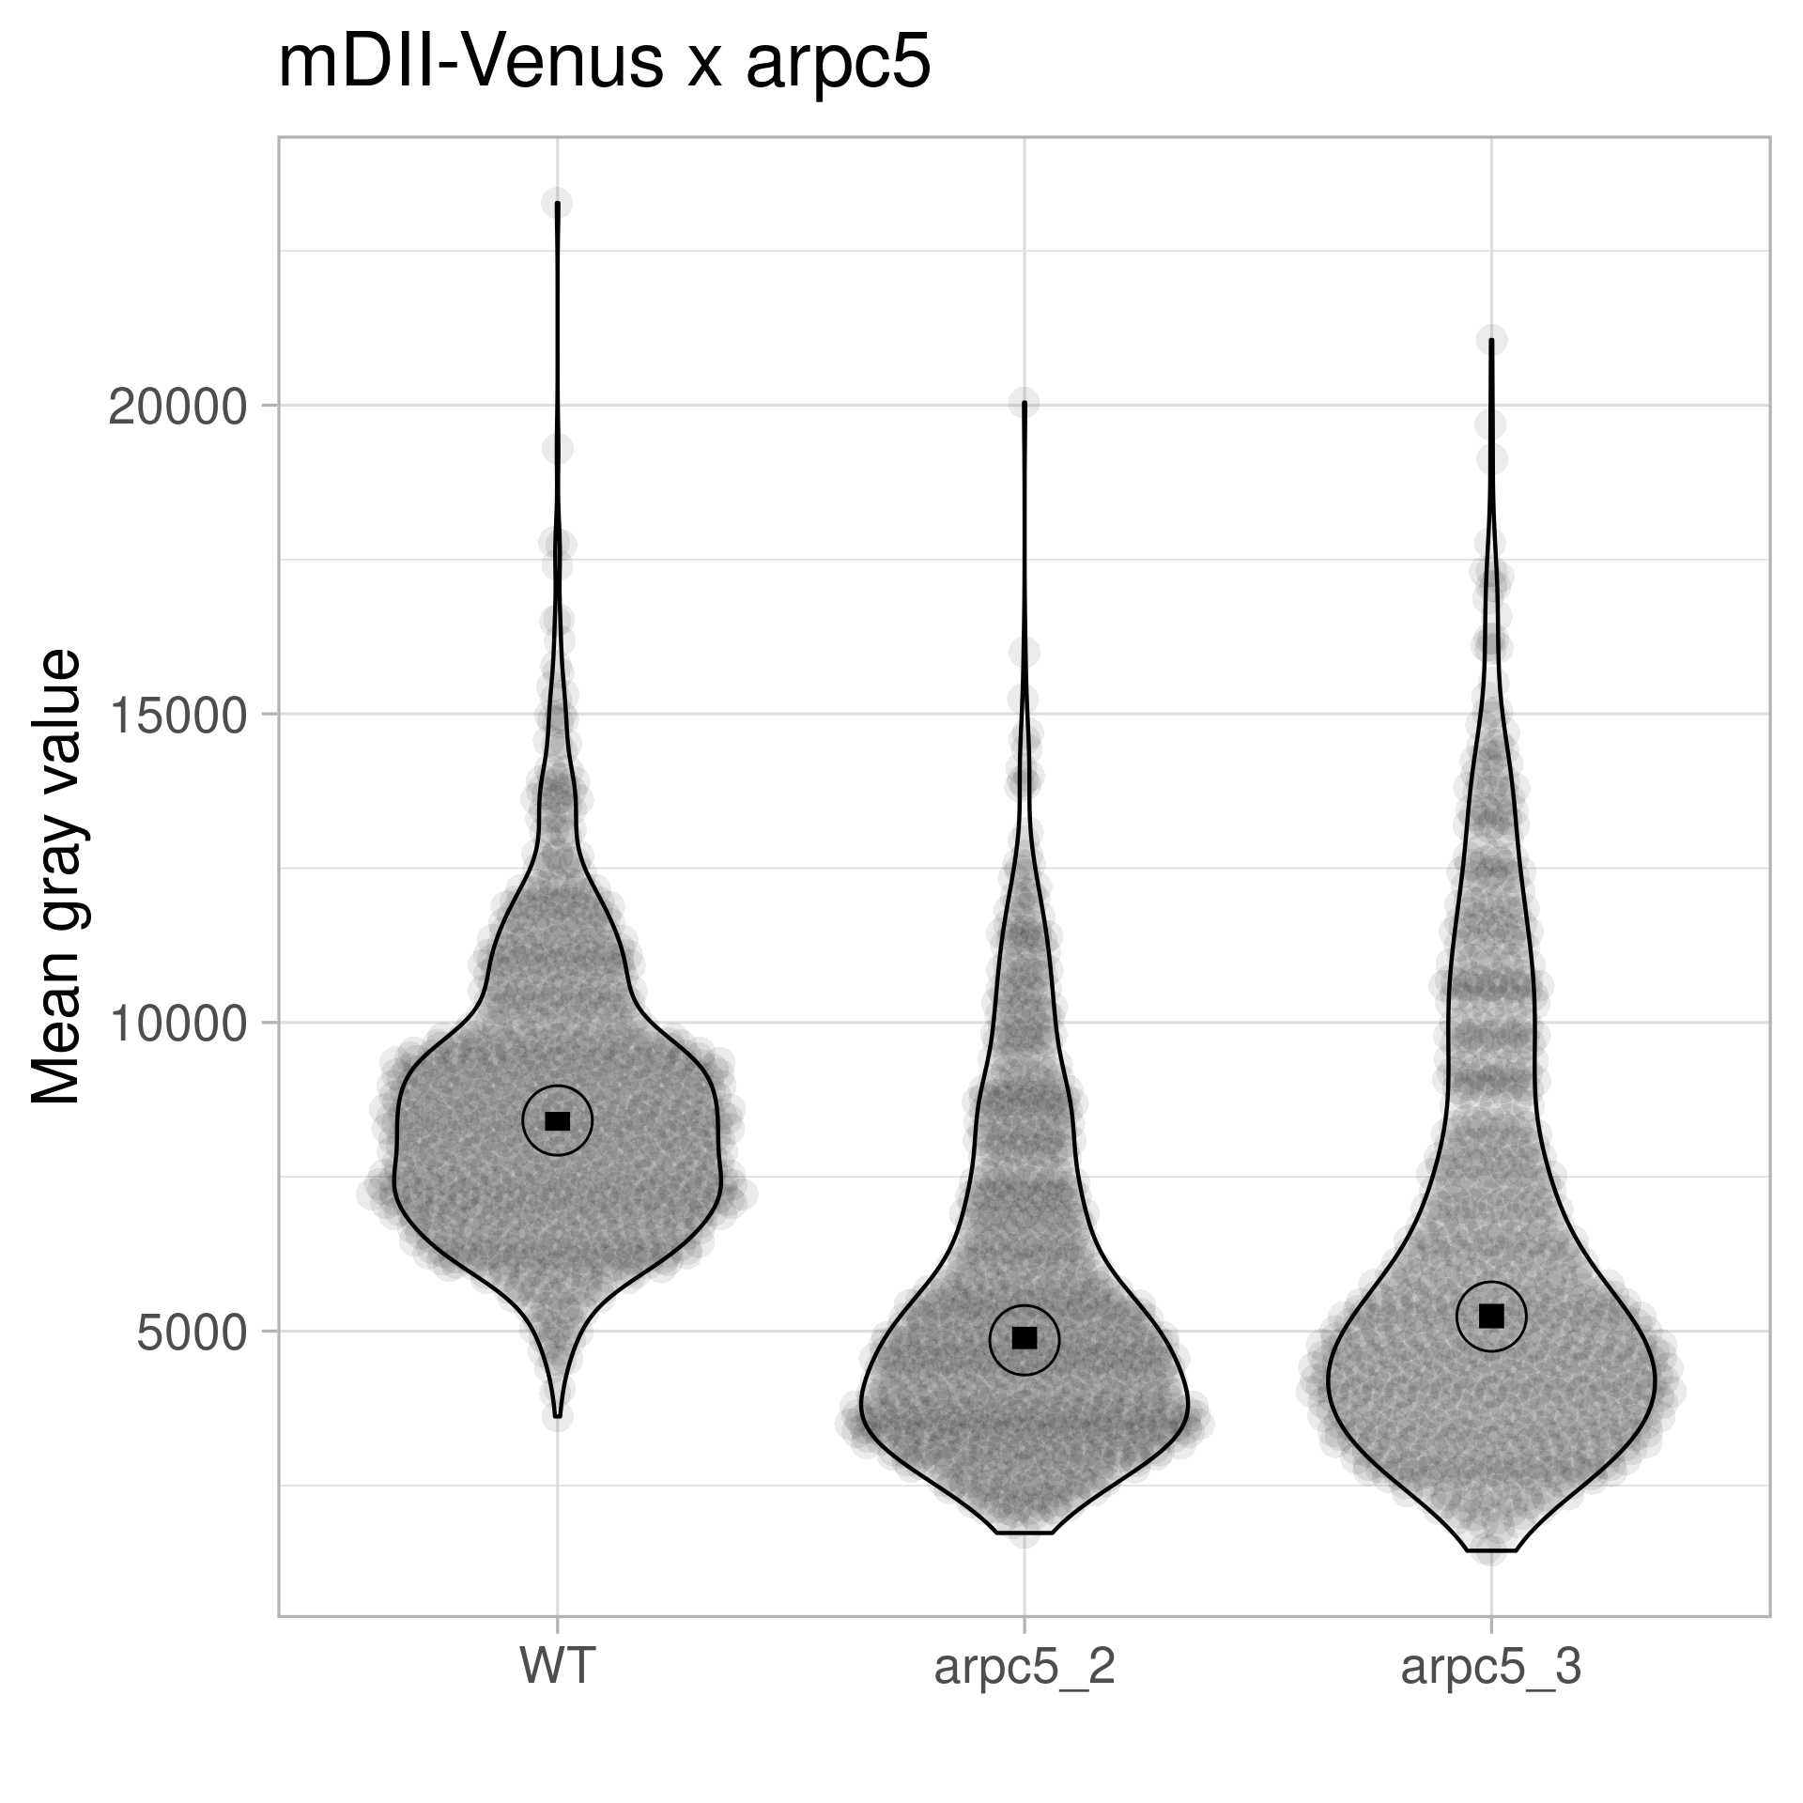
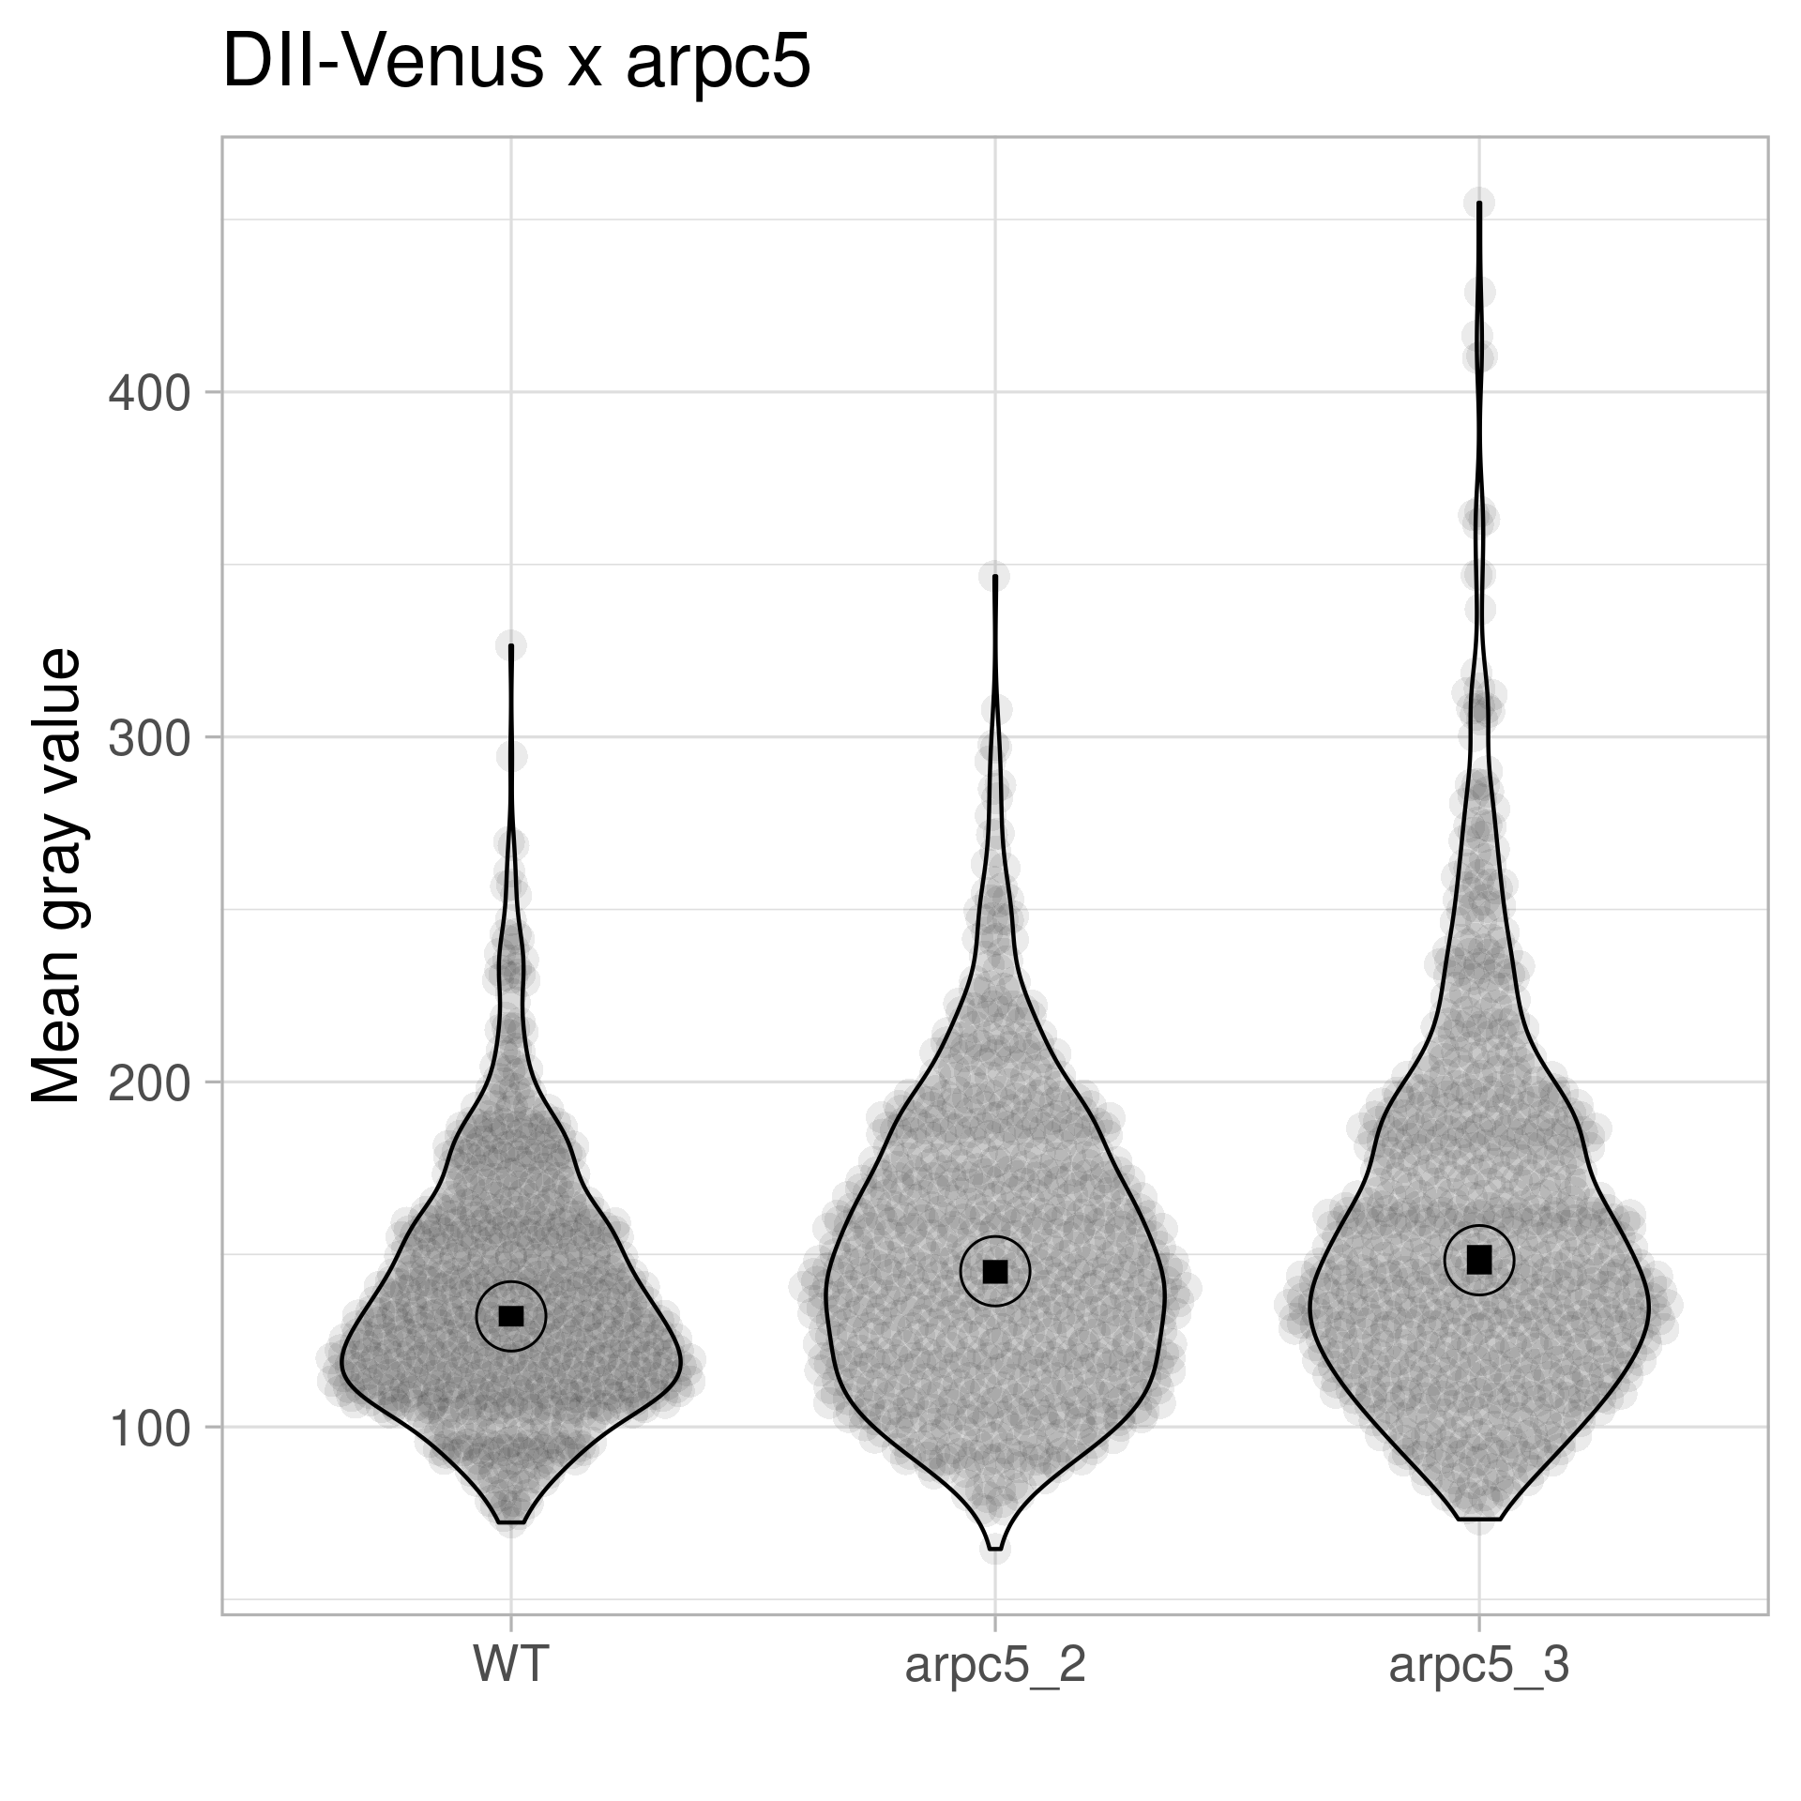
35S::mDII-VENUS x arpc5 35S::DII-VENUS x arpc5
Statistics – Violin Plot + 95% CI

Slide 7
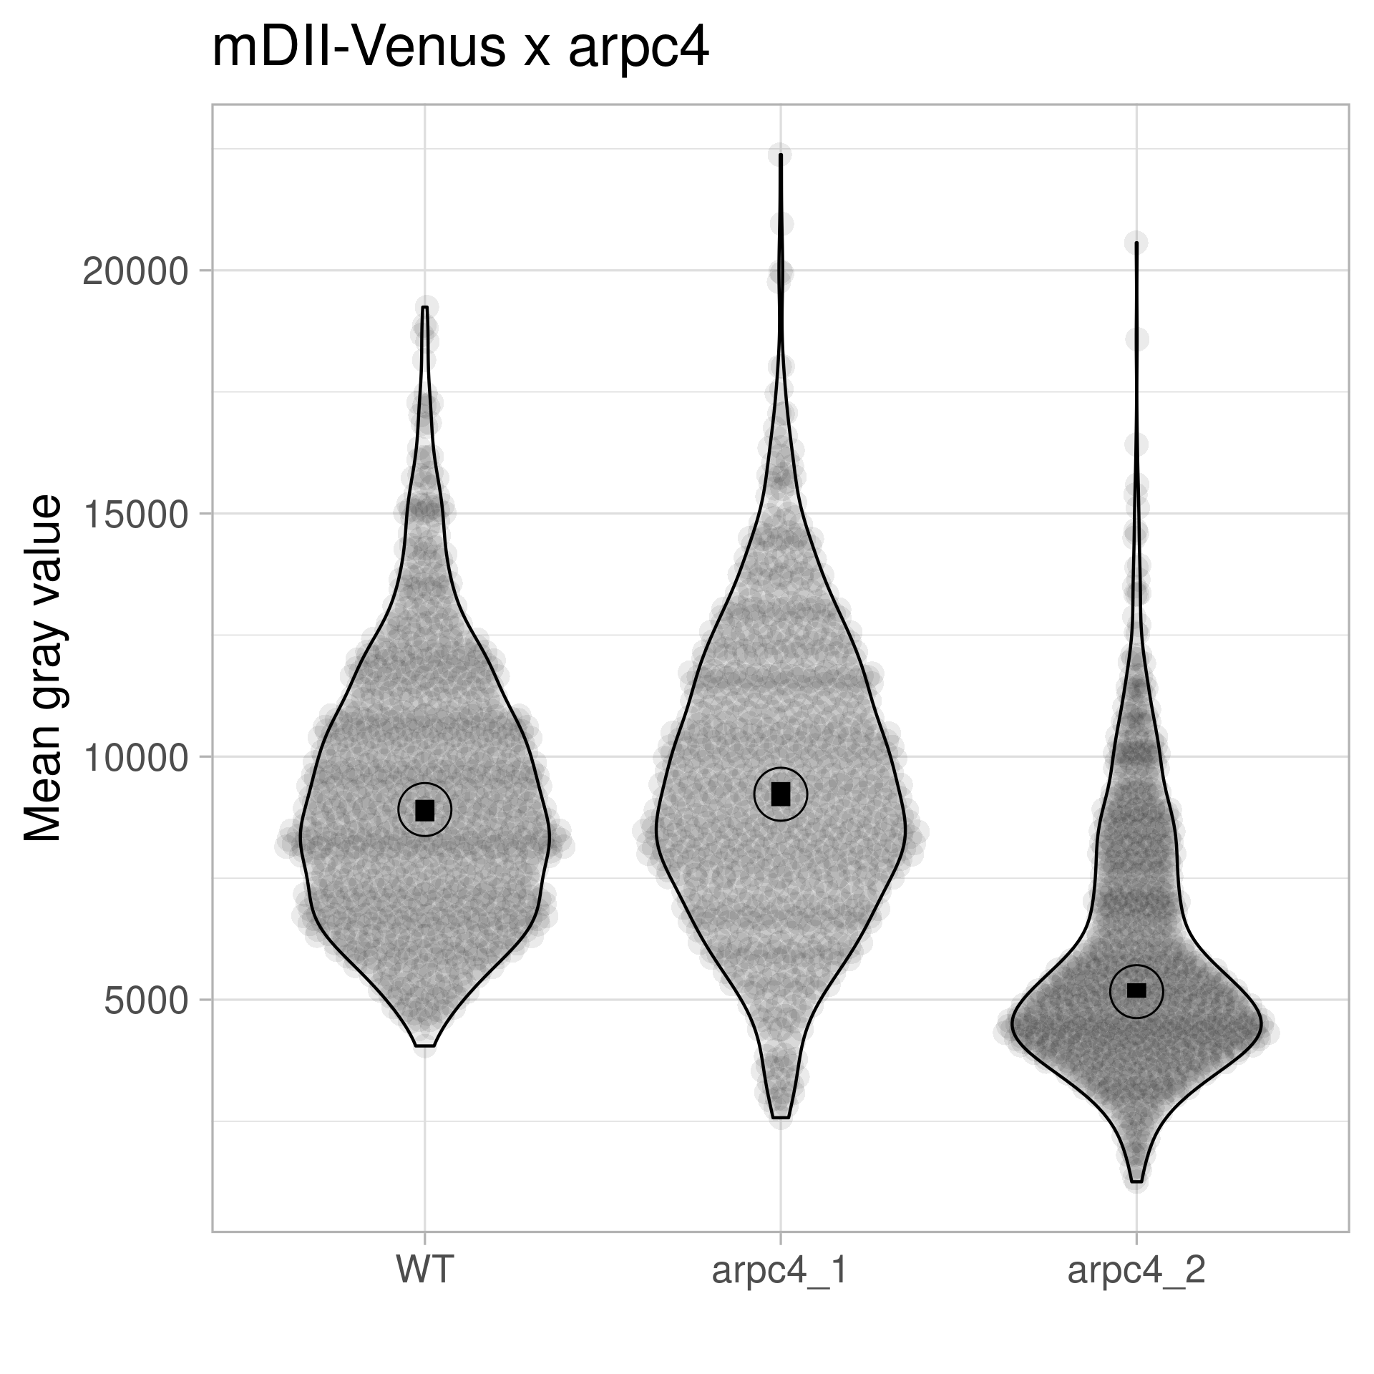
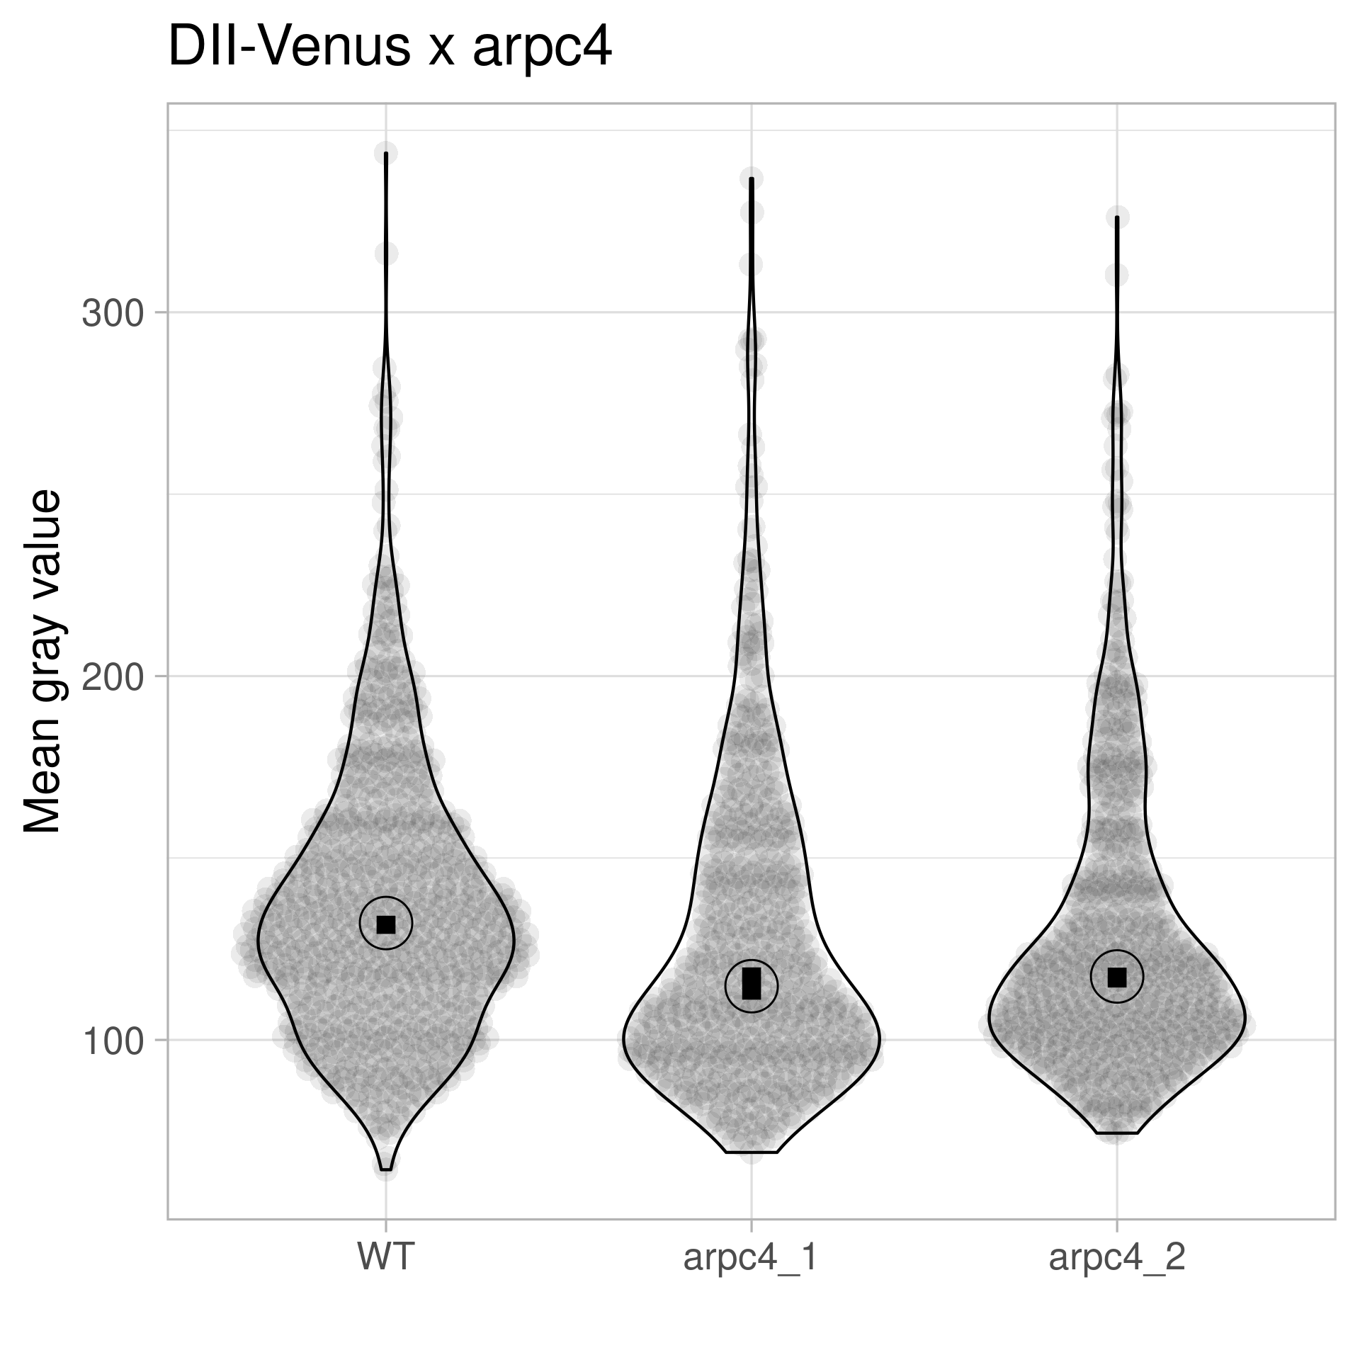
35S::mDII-VENUS x arpc4 35S::DII-VENUS x arpc4
Statistics – Violin Plot + 95% CI

Slide 8
35S::mDII-VENUS x arpc5 35S::DII-VENUS x arpc5 35S::mDII-VENUS x arpc4 35S::DII-VENUS x arpc4
Statistics – Violin Plot + 95% CI

Slide 9
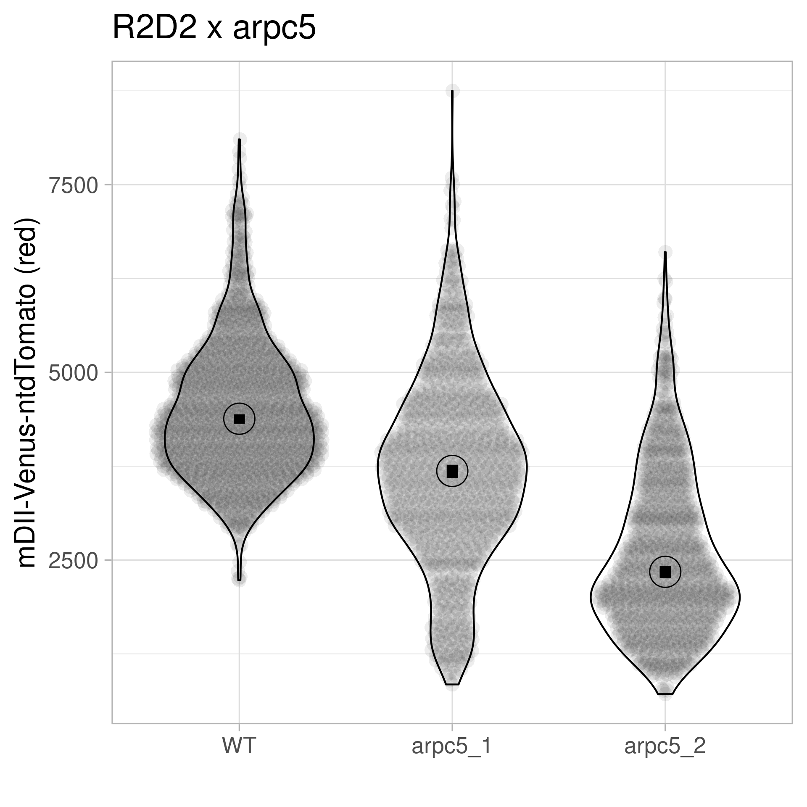
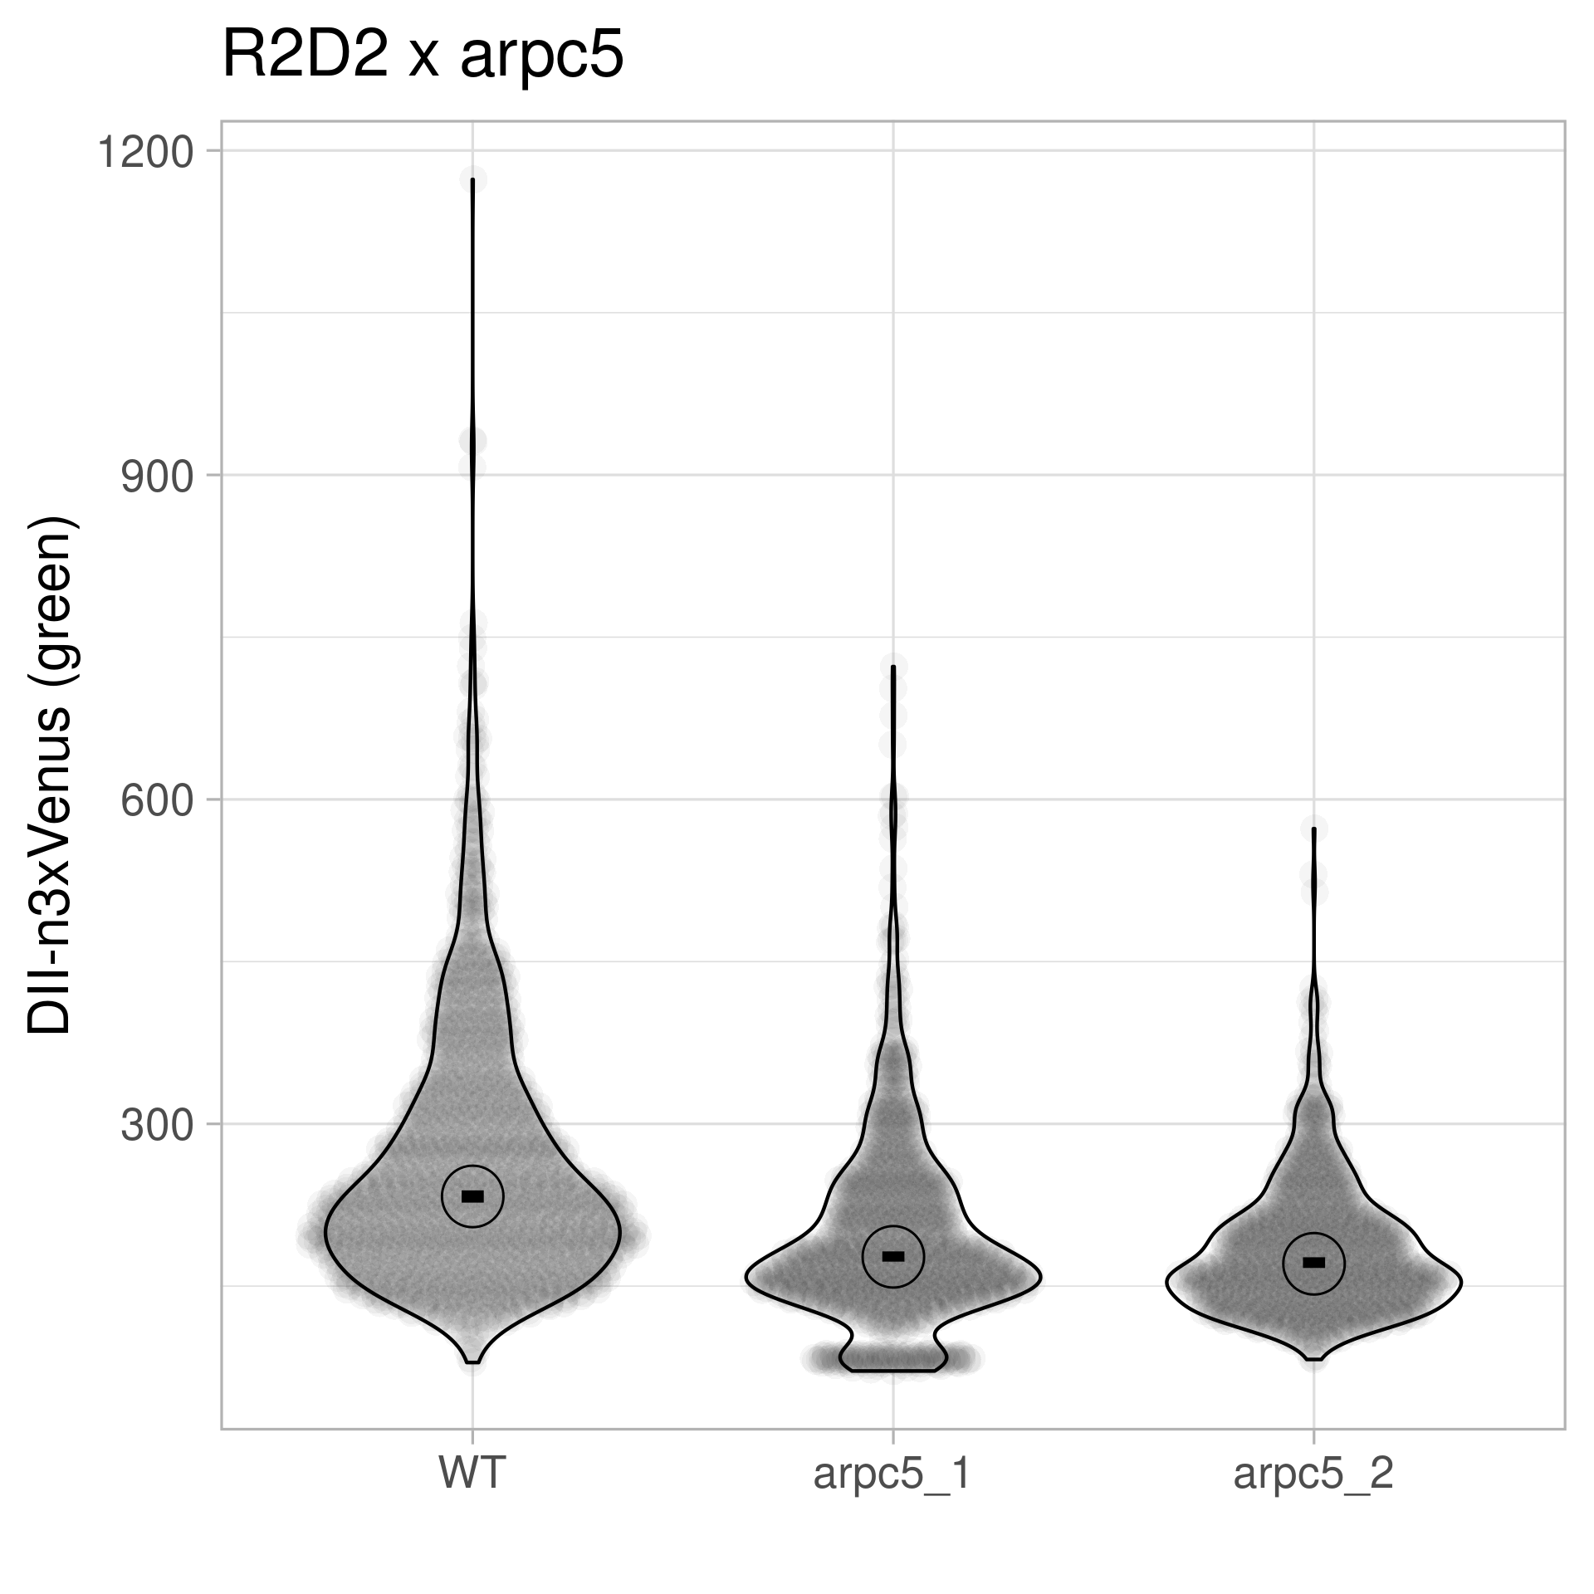
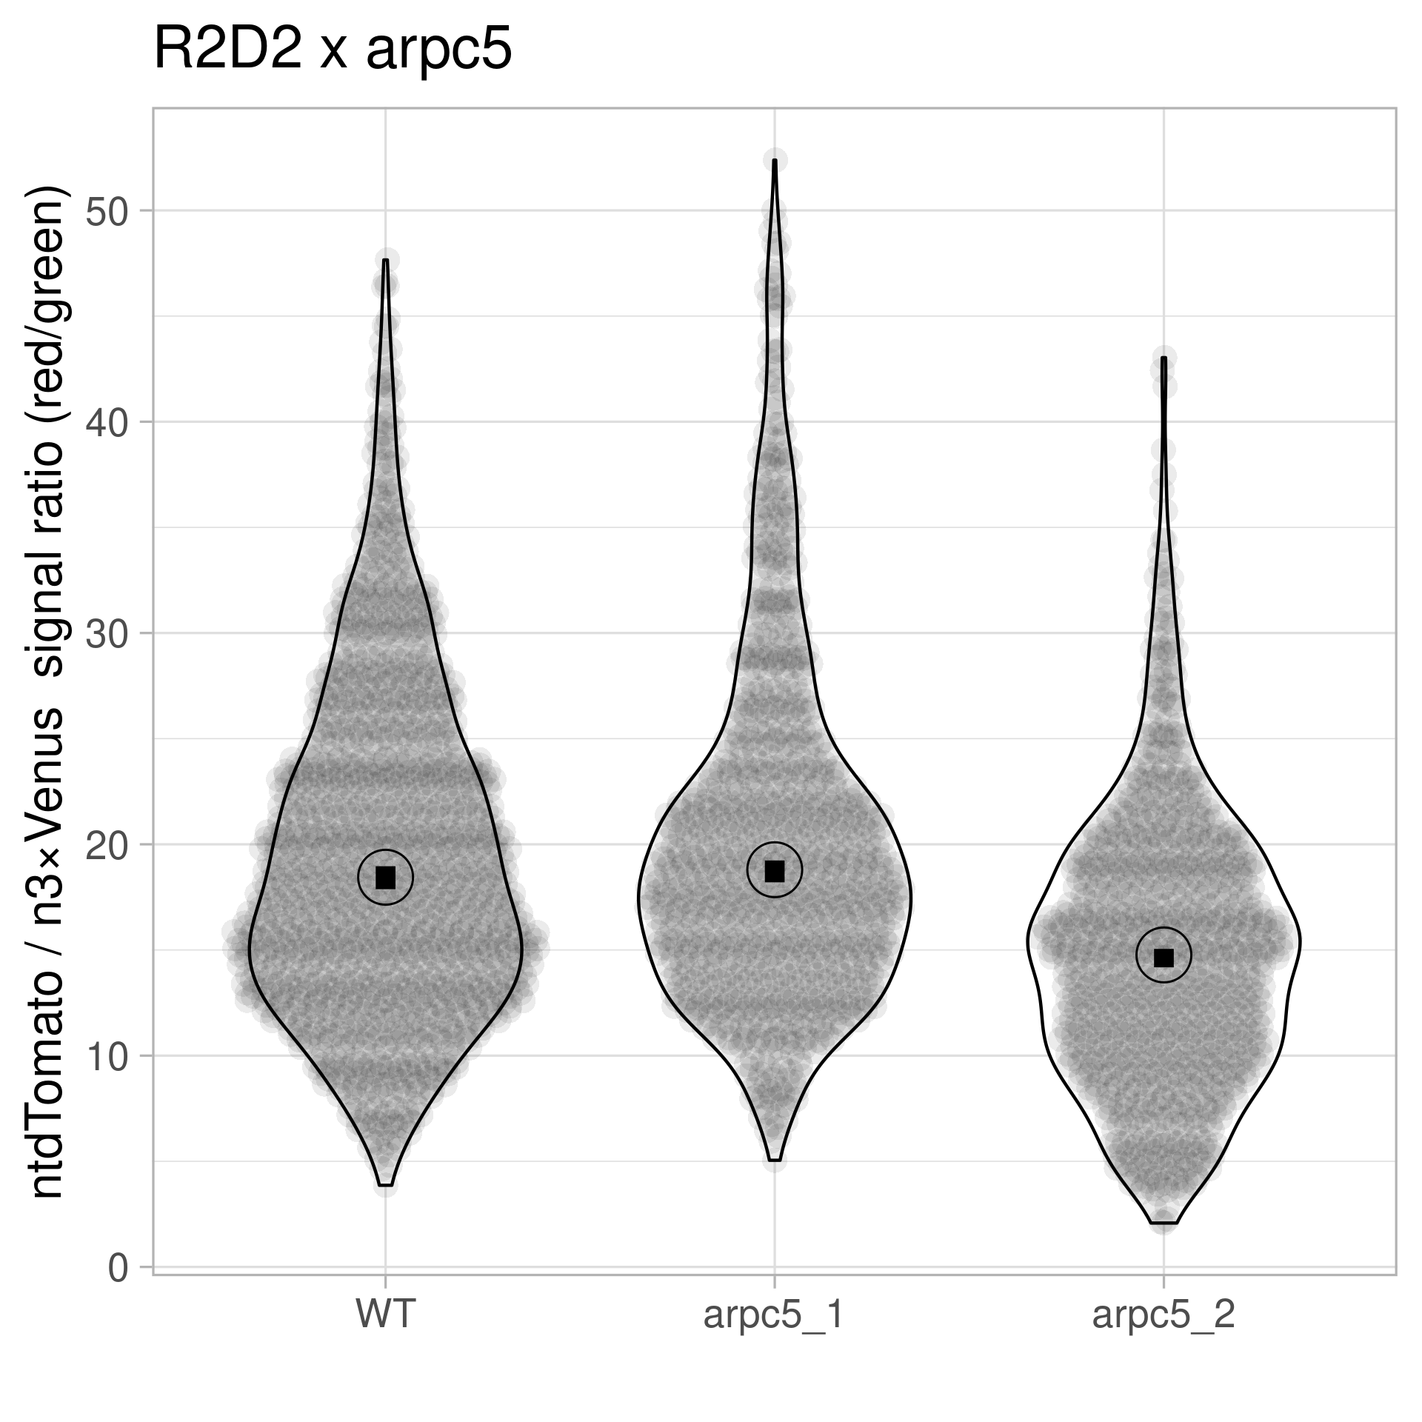
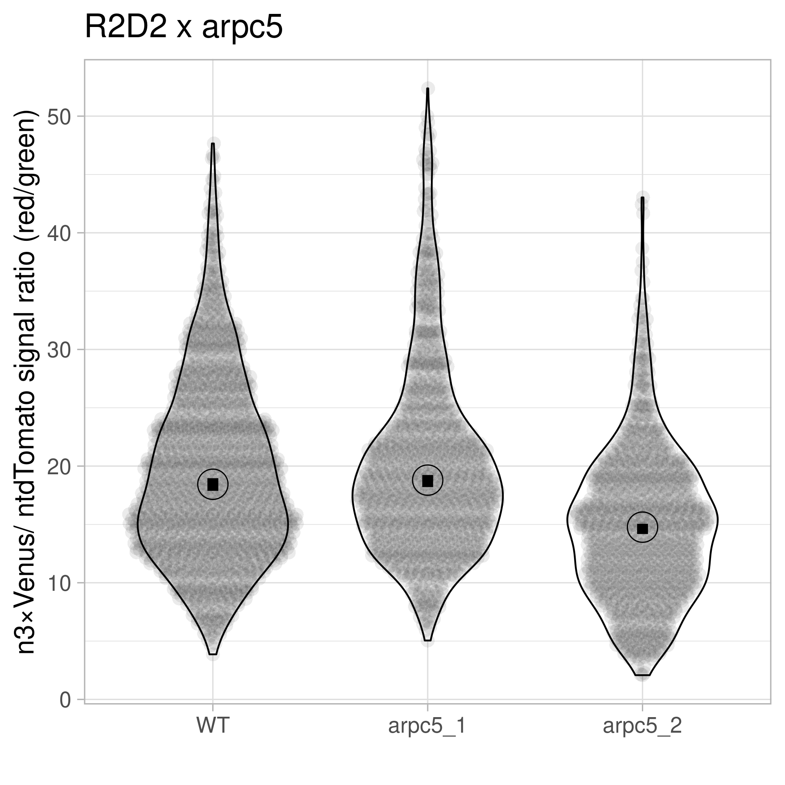
pGIIM/ RPS5A:: mDII: ntdTomato- RPS5A:: DII: n3Venus x arpc5
Statistics – Violin Plot + 95% CI

Slide 10
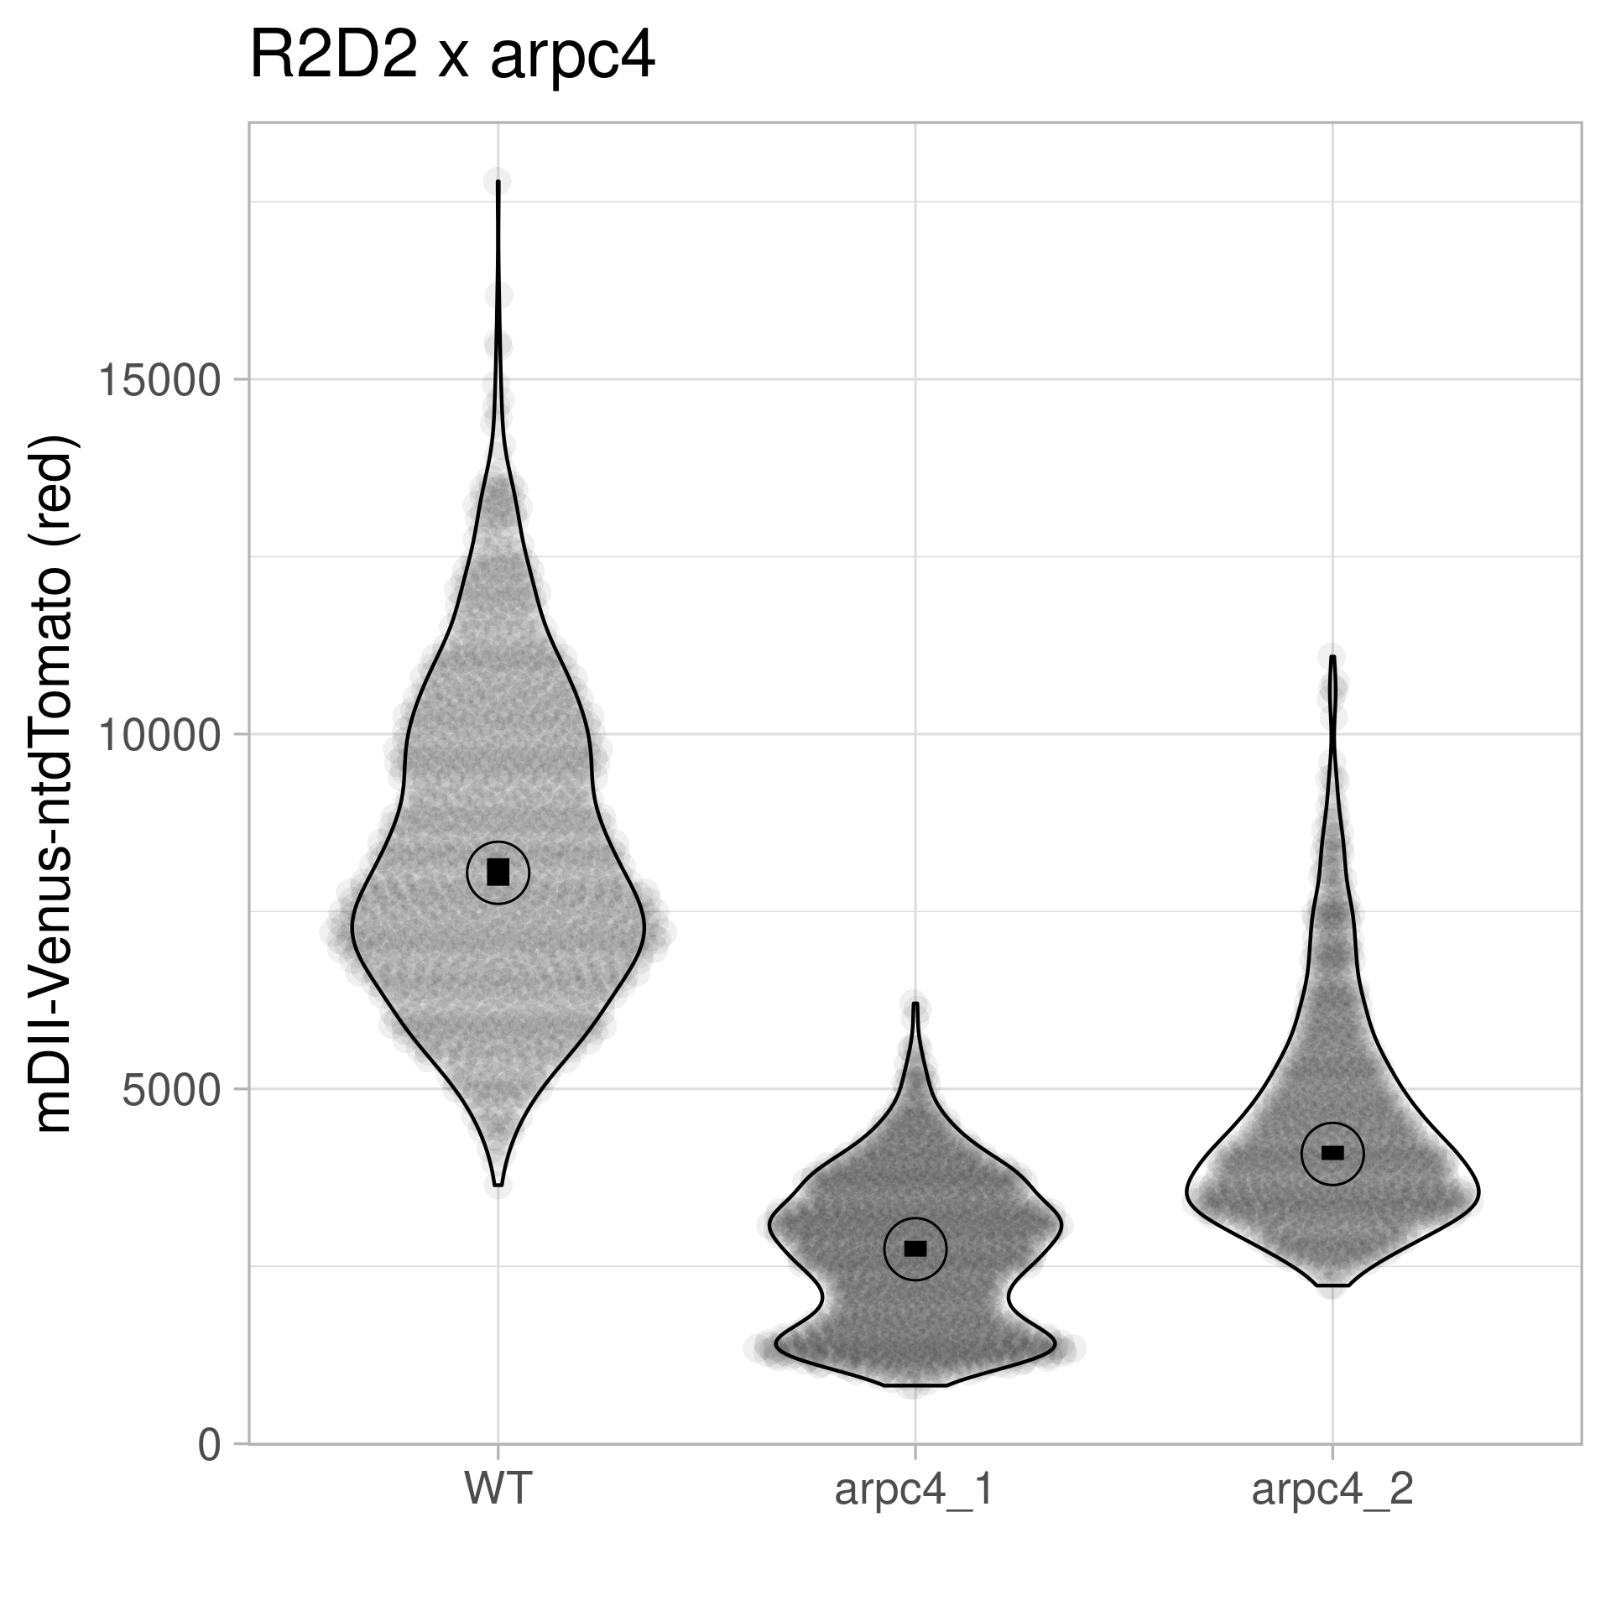
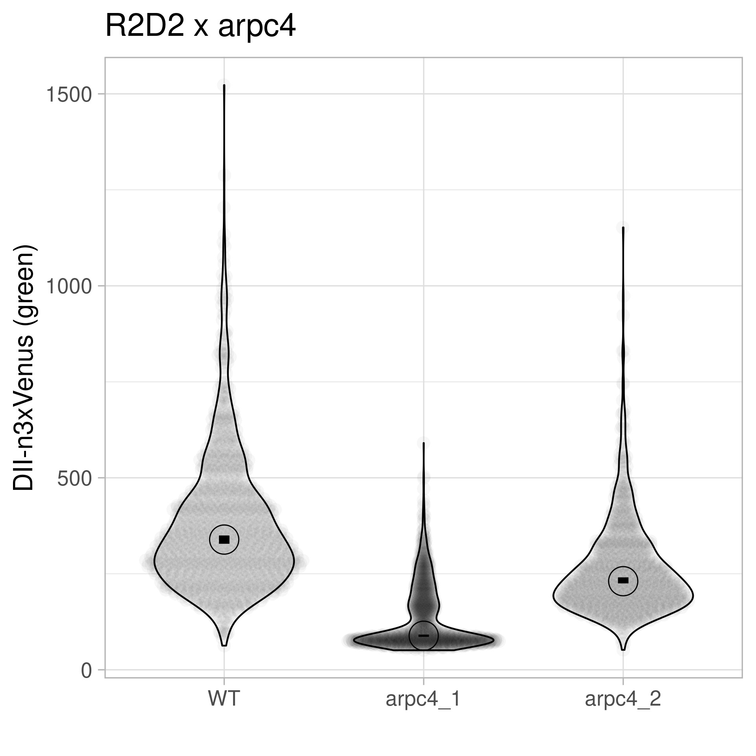
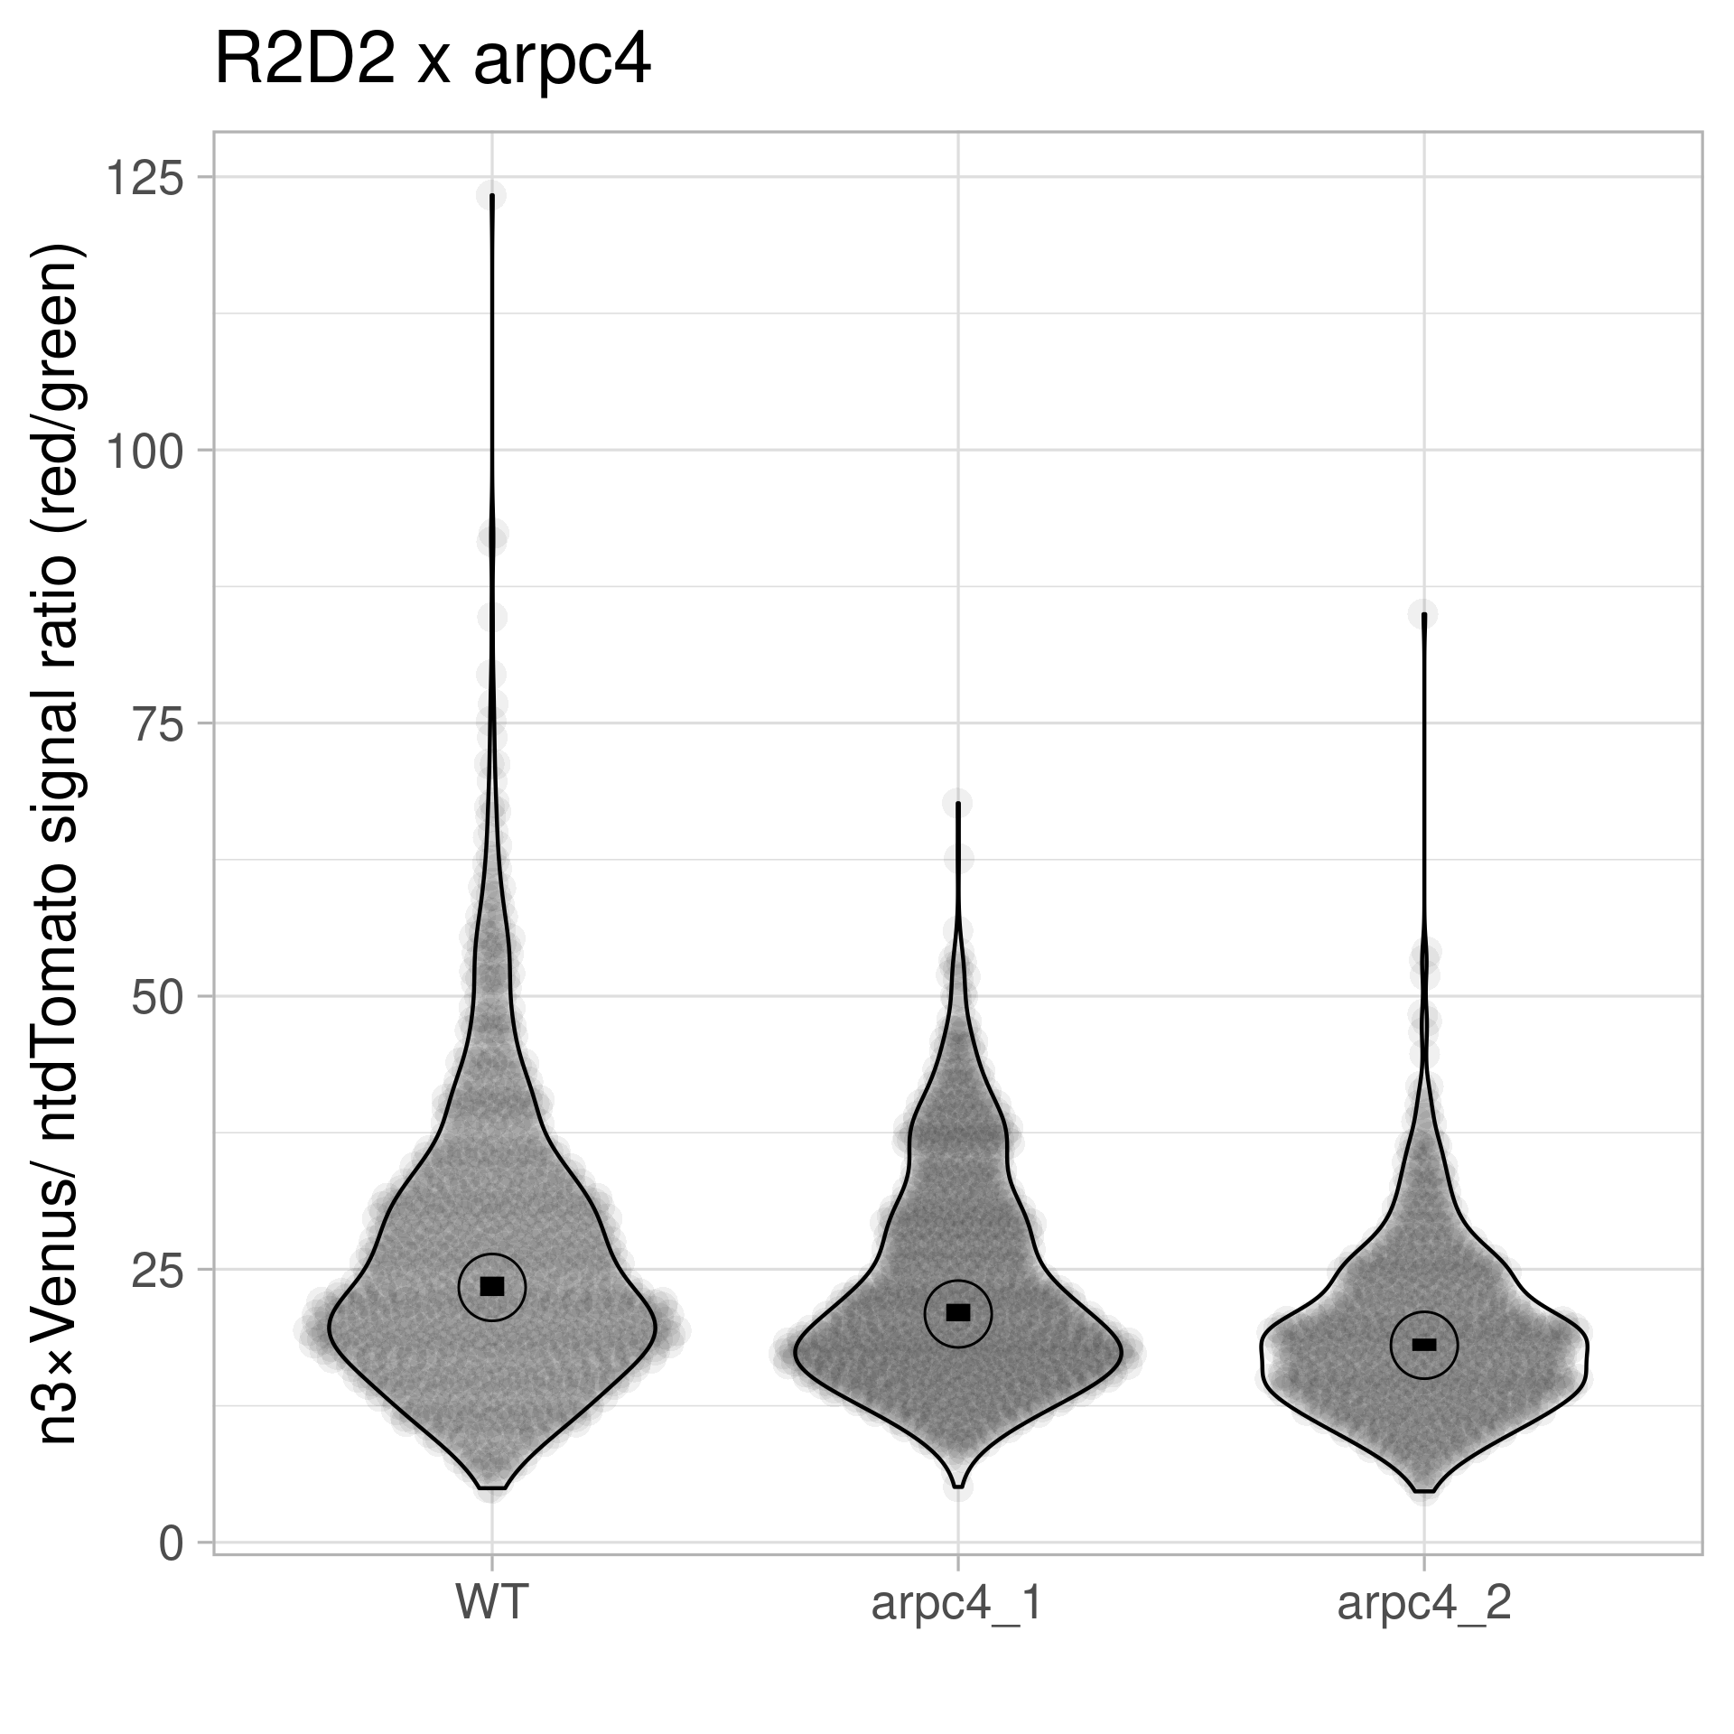
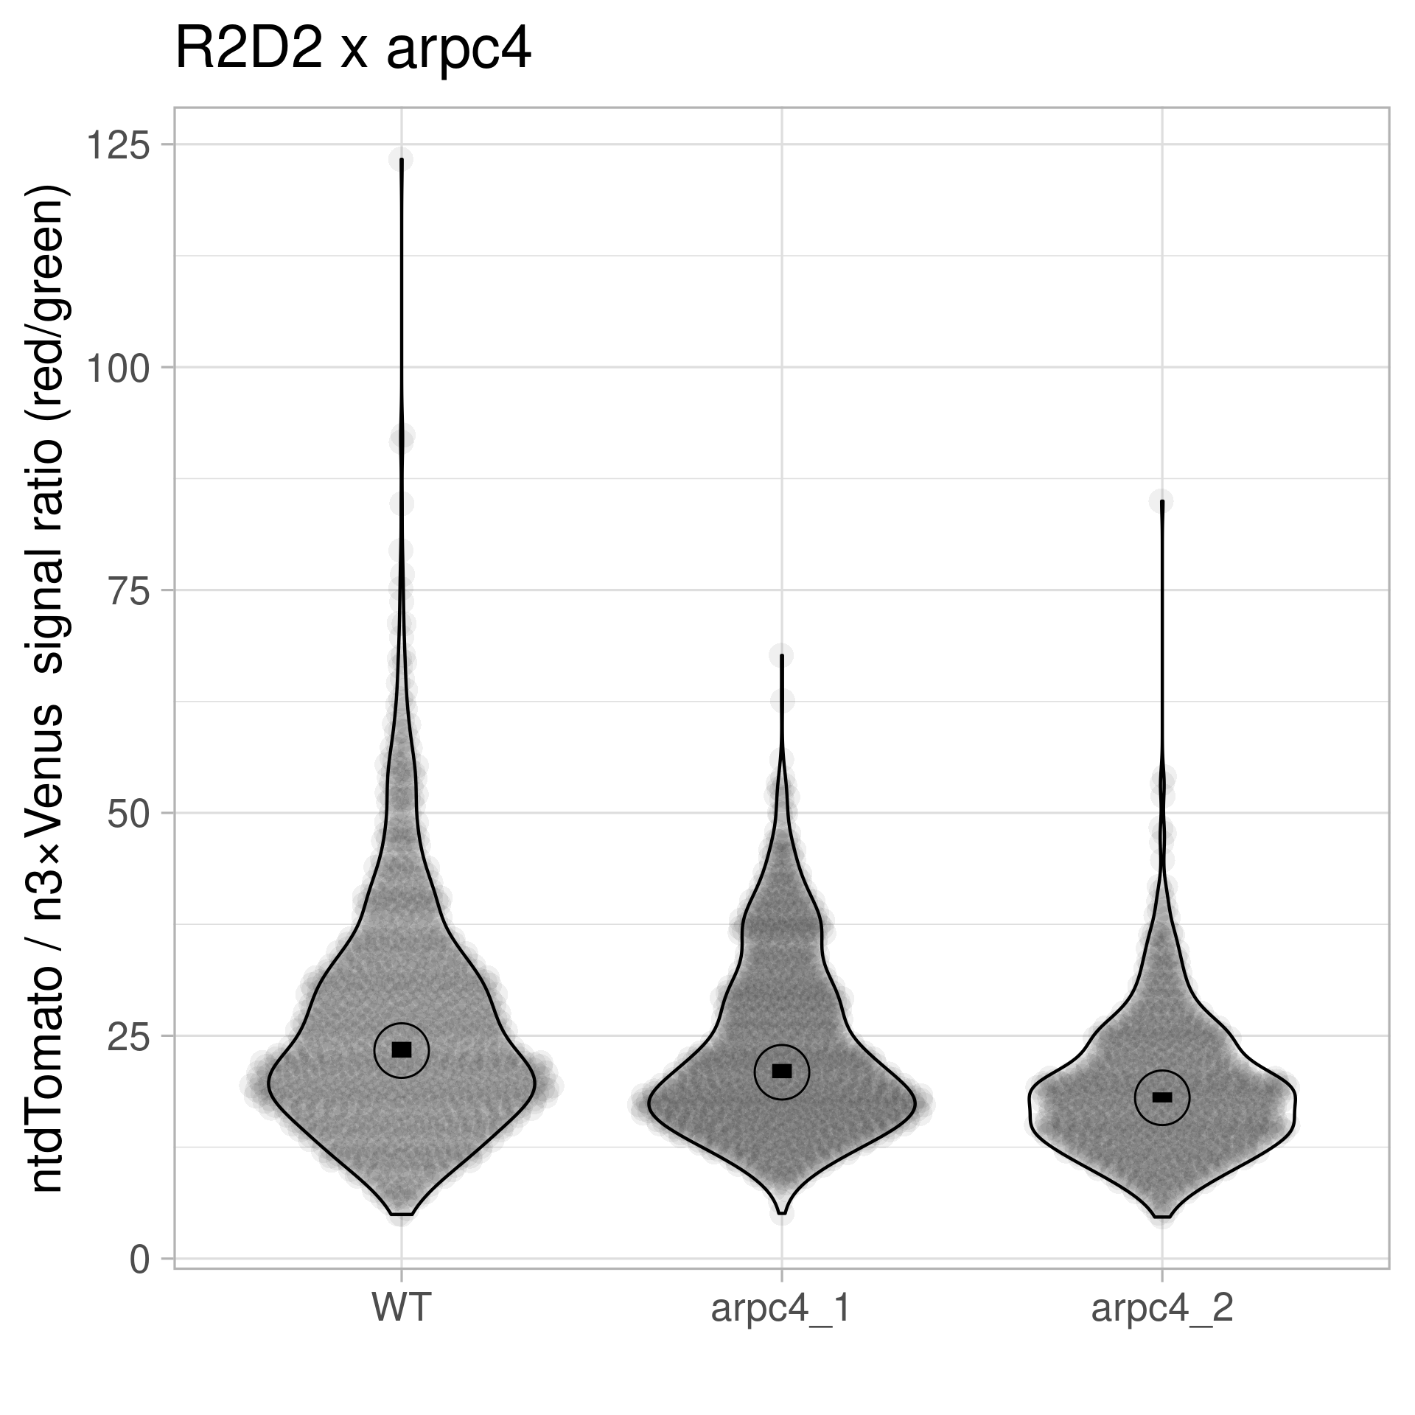
pGIIM/ RPS5A:: mDII: ntdTomato- RPS5A:: DII: n3Venus x arpc4
Statistics – Violin Plot + 95% CI

